Slide 1
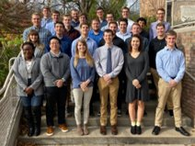
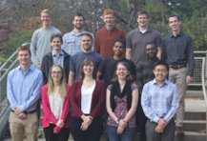
Energy Rebound Research
ENGR 333 - A
ENGR 333 - B
12/04/2019
Engineering 333 Fall 2019
Ivy Chipinda, Andrew Huston, Adam Marquardt, Lillie Spackman
Notes:
Slow down and explain who you are and the three other presenters
We’re representing all of the people in these two photos, the two sections of the class
We’re the ones presenting but the people who did the analysis are the ones shown in the picture here
Along with me, there will be Andrew and Adam and Lillie
Andrew will talk about how we organized the class
Adam will talk about a case study,
And Lillie will give the results from the entire class.
And it’s my job to introduce what’s going on; to understand the rest you need to pay attention now. Here we go!

Slide 2
Source: United Methodist Church. www.vaumc.org/Caretakers
Notes:
And in view of our common Christian commitment we’re interested in making wise use of our finite energy resources

Slide 3
Research Question
How much energy does energy efficiency save?
Notes:
If we want to save energy, one of the ways we think about doing that is with energy efficiency *pause*
There are three ways that energy efficiency might NOT save us energy
We’re going to explain the rest of these three things, but you need to clue in right now if you have any hope of understanding the rest of the presentation. So buckle up

Slide 4
How much energy does energy efficiency save?
Device
Embodied
Re_{EW}
Respending
Notes:
We’re going to look at these three types of rebound
Here is vaguely what they’re called
Device
Embodied
Respending
Economy Wide: our MACRO change that comes from our micro changes

Slide 5
Energy Savings
Device
Energy Savings
Energy Efficiency
Energy Efficiency
Notes:
Use Lillie’s icons to start, then explain with Ivy’s notations (same for embodied and respending)

Slide 6
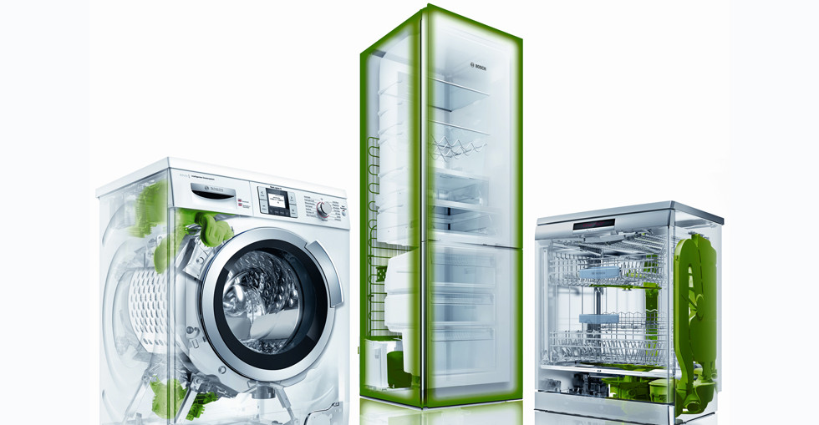
Embodied
Notes:
Great Job explaining embodied energy, Ivy. But explain that often the EE case has more embodied energy :)

Slide 7
Respending
Notes:
You can use the money to shop, but let’s talk about how that money gets spent through the economy… INFINTE SERIES FUN
Resepending has energy implications!!

Slide 8
Marginal Propensity to Consume
1
2
3
4
5
$$∞$$
. . . . . .
0.95
0.95
0.95
0.95
0.95
$1.00
$0.95
$0.91
$0.86
$0.81
. . . . . . . .
$$=$$
$19
4MJ/$
Infinite Series
$$=$$
76 MJ
Respending
Notes:
Respending rebound happens because of this thing economists call “The marginal propensity to consume”
Explain it with an infinite series that converges and your lil’ stick figures
Name: 0.95 is our marginal propensity to consume in this case
Make sure to label MPC
Savings are like a tax cut. Get to spend more and more
Heun's Notes 12/4: "Say this is an interesting series that converges". Make the barrel get smaller. See Heun's drawing on the board.

Slide 9
How much energy does energy efficiency save?
Device
Embodied
Re_{EW}
Respending
Notes:
Researchers speculate that these three mechanism exist, what we’re doing is exploring how these mechanisms work together and which (if any) is most influential in economy wide rebound.
Ivy: I talked about the ways we’re answering our question, now Andrew is going to explain how we went about this in our actual class scenario and how we QUANTIFIED REBOUND

Slide 10
Base Case vs Energy Efficient Case
Notes:
Explain the base and EE ideas
We had a total of ten teams
Two interventions per team
One large, one small
One on campus, one off campus
For every intervention, there is a BASE case and an EE case (SEPARATE SLIDE)
Each team of 3-4 students studied two topics
--one large scale topic
--one small scale topic
Some topics were studied by multiple groups (eg windows, computers, smart power strips, etc)
End up with a total of 20 devices (next slide w/ transitions)

Slide 11
Equation for Rebound
$$ReEconomyWide=1−\frac{{\dot{E}}_{savings,economy wide, net}}{{\dot{E}}_{savings,device,direct,expected}}$$
$$ReEconomyWide=1−\frac{0}{\dot{E}}=1$$
$$ReEconomyWide=1−\frac{\dot{large E}}{\dot{E}}<0$$
$$ReEconomyWide=1−\frac{\dot{E}}{\dot{E}}=0$$
$$ReEconomyWide=Redev+Reemb+Rerespend$$
Notes:
We as researchers put a number on our phenomena
If this happens, we can quantify it with this (the only) equation we have in the presentation
We can quantify how much energy we don’t save and call it REBOUND
Walk through the equation
And now we’re going to explain the three ways where you might not save energy
Explain in more detail
--add logos
-- add eqns

Slide 12
How much energy does energy efficiency save?
Hyperconservation
Rebound
Backfire
0%
100%
Save exactly as much
energy as expected
No savings
(Use exactly as much
energy as the base case)
$$ReEconomyWide=1−\frac{{\dot{E}}_{savings,economy wide, net}}{{\dot{E}}_{savings,device,direct,expected}}$$
Notes:
You can even explain the color
Hyperconservation
You save more energy than you expected to
Rebound
You used more energy than you expected to
Backfire
You used more energy than you did before
We’re talking about a transition from an older, energy hogging device to a newer EE case (see next slide)

Slide 13
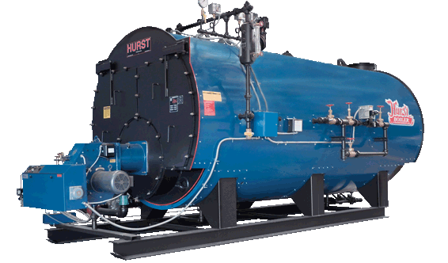
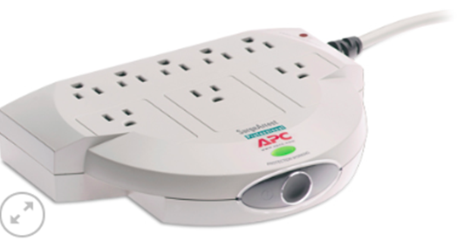
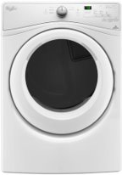
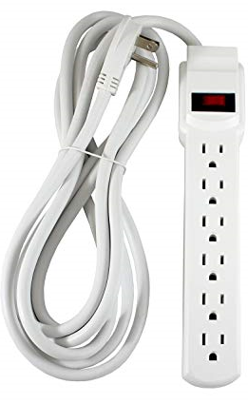
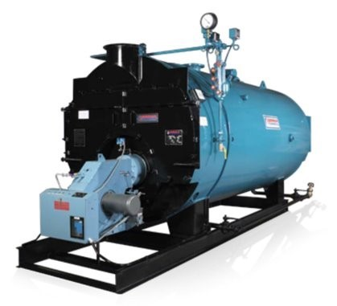
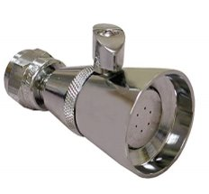
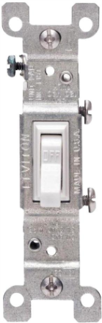
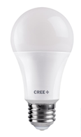
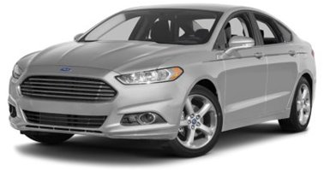
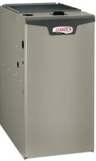
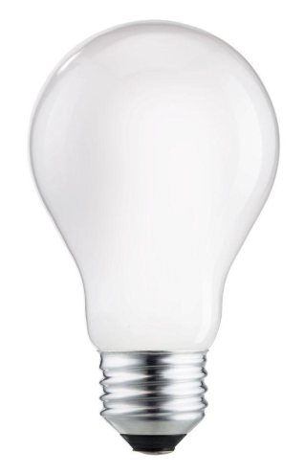
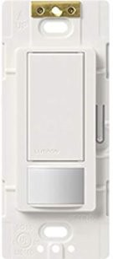
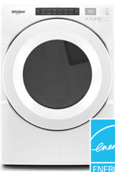
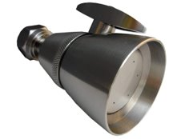
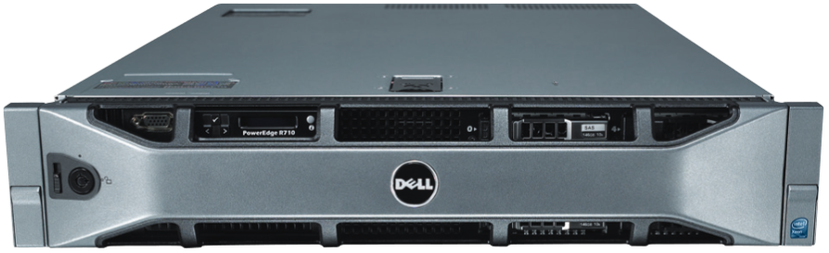
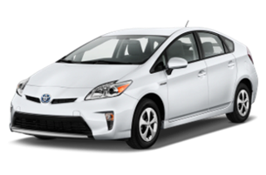
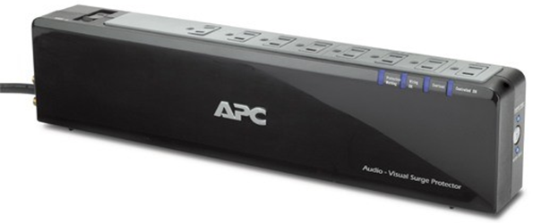
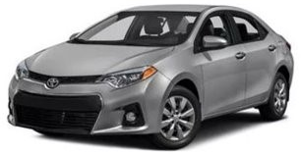
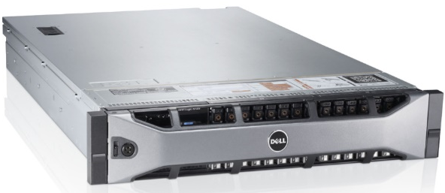
Devices Studied
Notes:
We had a total of ten teams
Two interventions per team
One large, one small
One on campus, one off campus
For every intervention, there is a BASE case and an EE case (SEPARATE SLIDE)
Each team of 3-4 students studied two topics
--one large scale topic
--one small scale topic
Some topics were studied by multiple groups (eg windows, computers, smart power strips, etc)
Transition: Adam is going to explain one project in great detail so you understand the detail that went into the calculations for every team
Heun’s Notes: All pictures, no words. Pictures that pop up slowly and fade in. Just talk generally “we studied a lot of energy interventions”

Slide 14
Devices Studied
Notes:
We had a total of ten teams
Two interventions per team
One large, one small
One on campus, one off campus
For every intervention, there is a BASE case and an EE case (SEPARATE SLIDE)
Each team of 3-4 students studied two topics
--one large scale topic
--one small scale topic
Some topics were studied by multiple groups (eg windows, computers, smart power strips, etc)
Monthly teleconferences with Professor Brockway
Transition: Adam is going to explain one project in great detail so you understand the detail that went into the calculations for every team
Heun’s Notes: All pictures, no words. Pictures that pop up slowly and fade in. Just talk generally “we studied a lot of energy interventions”

Slide 15
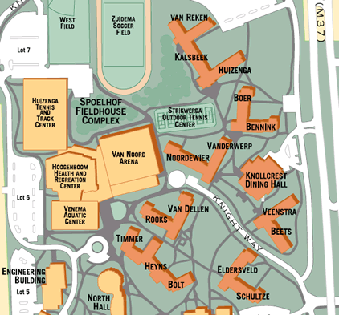
Case Study: Tennis and Track Lighting Control System
Notes:
From Andrew: yep, he’s right. I’m going to explain a situation that we all are familiar with, something you may have never even noticed before. But it was done with intention.
Heun’s Notes: Get rid of words, use graphics, put in section of the device level rebound.
Heun’s Notes 12/2: Compare hours of usage to each other. This is the source of the rebound. Remind the audience that this is actual data, not hypothetical. Bring back in the “Behavior change ahead” sign for continuity.

Slide 16
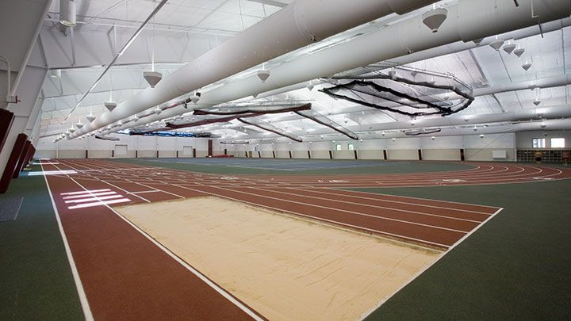
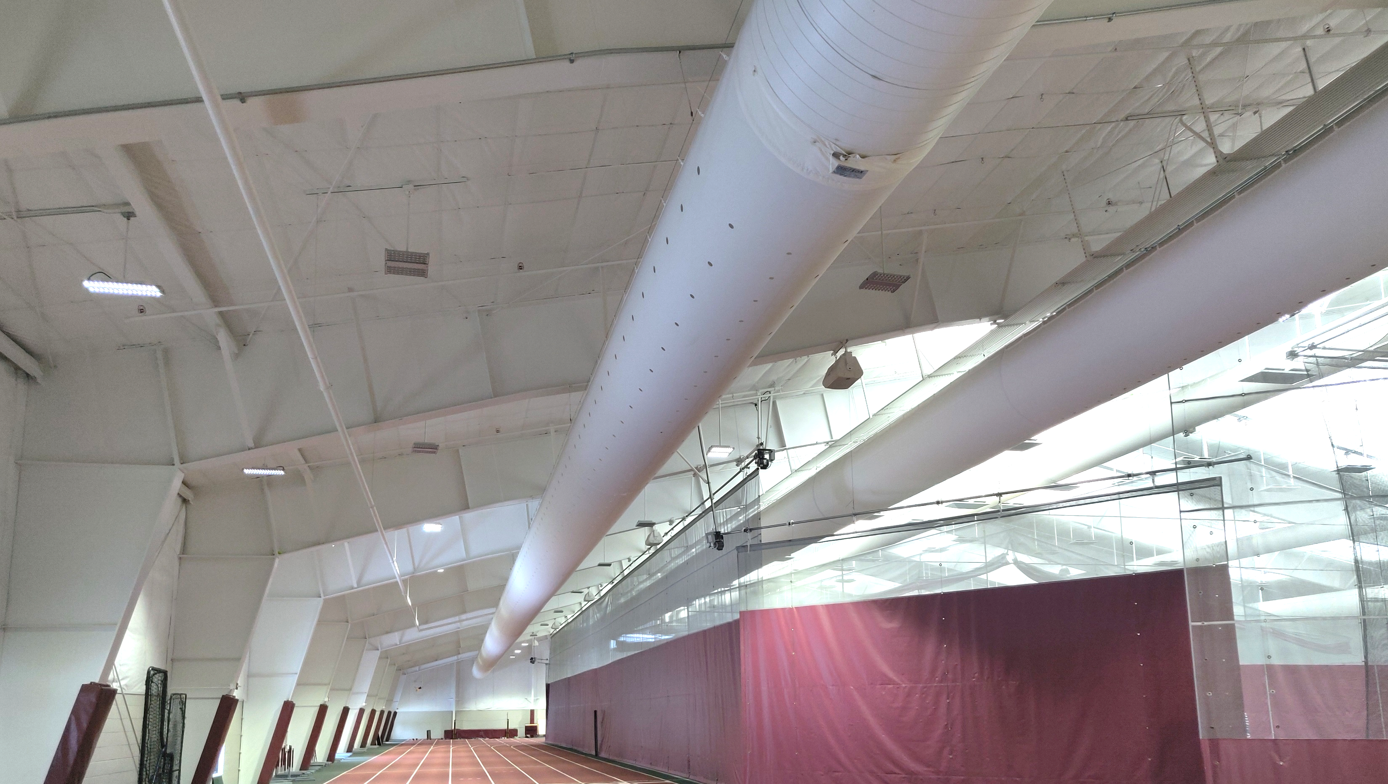
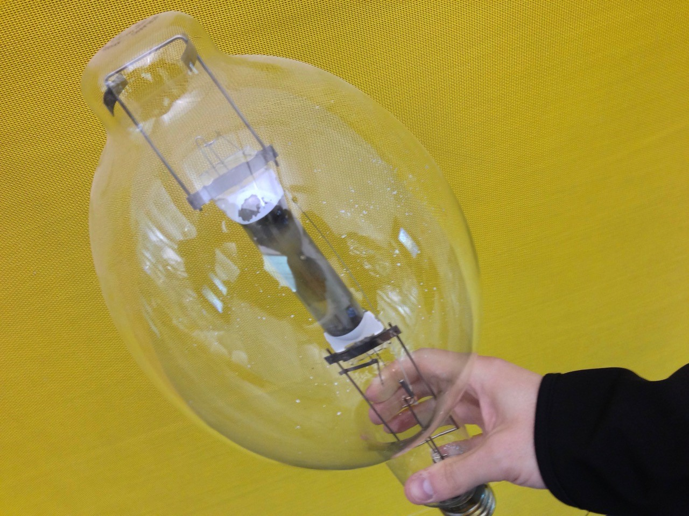
Case Study: Tennis and Track Lighting Control System
Notes:
Brighten up the second picture
Don’t auto-animate. Take time to walk through the details

Slide 17
How much energy does energy efficiency save?
Device
Embodied
Re_{EW}
Respending
Notes:
Ivy showed you this graph before, I’m going to explain the details of how these three parameters worked together in our own specific project
As I go through, you notice the colored iconography in the lower left so you know exactly where I’m at in the explanation

Slide 18
Case Study: Tennis and Track Lighting Control System
2,740 hr/yr
3,169 hr/yr
Device
15%
Notes:
We’re probably using these lights more because they’re actually better
But that has energy implications
Remember our dev rebound behavior changes which has energy implications, we’re not saving as much energy as we expected to because we’re using the devices more often. That’s the definition of rebound.
Is this usage of the facility or usage of the lighting? Make sure to clarify that it’s usage of the lights specifically.

Slide 19
Case Study: Tennis and Track Lighting Control System
Embodied Energy 9x Larger
Usable Life 5x Longer
Embodied
1%
Notes:
Do the math to explain why embodied energy is larger for our EE case (distributed as MJ/yr)
Heun’s Notes: Pictures need to be more distinct. Adam to change this. If you are going to have the words on the slide you need to actually talk about it.
Heun’s Notes 12/2: Get rid of the variable names. Explain how you got this number. Why EE is bigger (more energy intensive materials)
Response: ${\dot{E}}_{embodied,lights,base}=6,691$[MJ/yr], ${\dot{E}}_{embodied,lights,EE}=15,184$ [MJ/yr]

Slide 20
Case Study: Tennis and Track Lighting Control System
$9,504 [$/yr]
$8,721 [$/yr]
Respending
Notes:
Money went from one number to another number, which lead to this much savings. Which has energy implications when we spend money in the economy. That leads to the respending rebound
Energy cost savings
Energy savings and dollar savings are often analogous.
Heun’s Notes: Pictures need to be more distinct. Adam to change this. If you are going to have the words on the slide you need to actually talk about it.
Heun’s Notes 12/2: Have a better intro. Explain that we were just talking about the theoretical ideas of rebound but now I am going to walk you through how we thought about a single project – lights. Get rid of all the bullet points and put them in the notes and just speak them.
Metal Halide Lights
142 units
1000 Watt per unit
Long warm-up time
Short life span – 4 years
LED lights
206 units
Average of 184 Watts per unit
No warm-up time
Extremely long lifespan – 20 years

Slide 21
Case Study: Tennis and Track Lighting Control System
1,519,747 [MJ/yr]
374,043 [MJ/yr]
$30,598 [$/yr]
$7,531 [$/yr]
Respending
148%
Notes:
Heun’s Notes: Pictures need to be more distinct. Adam to change this. If you are going to have the words on the slide you need to actually talk about it.
Heun’s Notes 12/2: Have a better intro. Explain that we were just talking about the theoretical ideas of rebound but now I am going to walk you through how we thought about a single project – lights. Get rid of all the bullet points and put them in the notes and just speak them.
Metal Halide Lights
142 units
1000 Watt per unit
Long warm-up time
Short life span – 4 years
LED lights
206 units
Average of 184 Watts per unit
No warm-up time
Extremely long lifespan – 20 years

Slide 22
Equation for Rebound
$$ReEconomyWide=Redev+Reemb+Rerespend$$
164%
=
15%
+
1%
+
148%
Notes:
We as researchers put a number on our phenomena
If this happens, we can quantify it with this (the only) equation we have in the presentation
We can quantify how much energy we don’t save and call it REBOUND
Walk through the equation
And now we’re going to explain the three ways where you might not save energy
Explain in more detail
--add logos
-- add eqns

Slide 23
Case Study: Tennis and Track Lighting Control System
Hyperconservation
Rebound
Backfire
0%
100%
Re_{EW}
Notes:
Think about just putting a big red dot there for T&T, with a picture to represent it instead of words.
Also, bigger. ☺

Slide 24
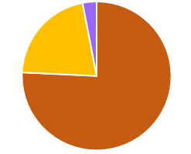
How much energy does energy efficiency save?
Re_{EW}?
Hyperconservation
Rebound
Backfire
0%
100%
φ_{respend}
90%
φ_{device}
9%
Re_{device}
15%
Re_{respend}
148%
φ_{embodied}
1%
Re_{embodied}
1%
Notes:
Understanding individual calculations, now comes the fun part: the results!
To answer our research question, we’re interested in two thing:
Cue 1: The value of Economy Wide rebound
Cue 2: does it fall below 0, in hyperconservation?
Cue 3: between 0 and 100%, rebound?
Cue 4: over 100%, as backfire?
But we’re also interested in how our three parameters contribute to economy wide rebound
Cue 5: sort of like a pie chart, we want to understand the composition of each device’s rebound
We do that by expressing each parameter as a fraction of that device’s Re_EW
Cue 6: To make it less confusing (or more confusing, depending on where you’re at so far in the presentation) we changed variables to phi, phi for fraction
But the trouble with representing our data like a pie chart is we would have a bunch of little pie charts
So turns out there is a type of graph that already exists that shows the composition of something in terms of the percent contribution of three parameters
Cue 7: It’s called a ternary graph, and you may have seen this one if you’re much into soils.
Other notes
Maybe fade out other graphs that you aren’t discussing

Slide 25
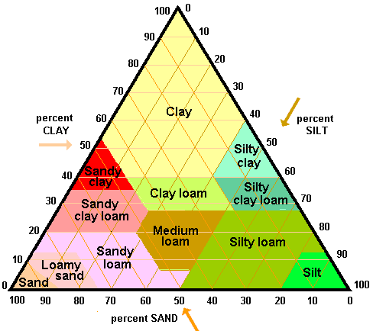
Ternary Graph
http://perezmaps.blogspot.com/2011/03/triangular-plot.html
Notes:
Explanation of the way to explain the composition of our parameters to economy wide rebound

Slide 26
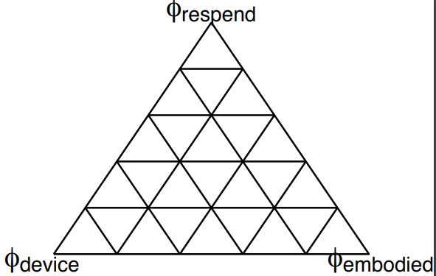
What is a ternary graph and how do we interpret it?
10% of Re_{EW}
from Re_{dev}
20%
30% of Re_{EW}
from Re_{emb}
60% of Re_{EW}
from Re_{respend}
40%
Re_{dev} contributes
0 % of Re_{EW}
Re_{dev} contributes
60 % of Re_{EW}
60%
Re_{dev} contributes
100 % of Re_{EW}
80%
80%
60%
40%
20%
Notes:
A ternary graph is just like a scatter plot with x-y axes, but with one more axis
Ternary graphs are good for explaining the composition of something: in our case, the composition of Re_EW
We’re going to take a minute and make sense of it so you can get a good idea for how significant our results are
Cues 1-3: Axes labels – circles appear around every axis label
The axis labels represent our three aspects of rebound;
Re_dev for device level rebound
Epsilon for embodied energy rebound
Respending for rebound do to respending
What are the units? It’s the percentage impact on Re_EW?
Cues 4: understanding the location on the graph
The farther you are from a vertex, the less of an impact that vertex has on Re_EW
Think of it like a flashlight: the farther away you are from the lightbulb, the less impact the light has
The farther away you are from a vertex, the less impact that variable has on Re_EW
If you’re off the graph it means… WHAT?
Cue 5-7: representing percent impact on the graph
100%
60%
0%
For any point on the graph, you have 100% of what you have, and you use the lines to located it based on composition
Cue 8-11: locating a specific point
20% from device
40% from embodied energy
40% from respending
If points are clustered towards a corner, most of the effect comes from that axis factor
Remember that the closer our points are to a vertex, the more impact that parameter has on economy wide rebound
Now that we understand how to interpret our results when we see them on a ternary graph, let’s take a look at our data
Heun’s notes 12/2:
Phi fonts don’t match previous slide – Heun is looking into it in R
Increase font of yellow words

Slide 27
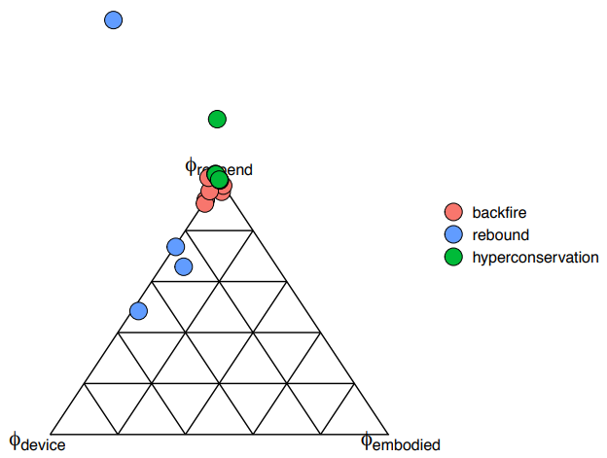
Overall Results
Notes:
In view of what we now know about ternary graphs, let’s take a look at our overall results
We’ll unpack them in more detail in a few slides, but we’ll start here
With all of our data taken together, it’s easy to see that the points definitely cluster
Cue 1: Cluster towards the respending vertex
This means respending is the highest contributor to economy wide rebound across the board
We do see some influence of the device level rebound
Embodied energy rebound is negligible in most every case
There are a few outliers, but we’ll note those in further detail later
But remember that the three contributors to economy wide rebound are just one level of the fun: there’s also the magnitude of the economy wide rebound itself
Cue 2: Here indicated by the color of the points
We’re going to unpack the three types of rebound a bit more here in the next few slides
Heun’s notes 12/2
Mention that each dot is one of the case studies
Slide graph to the right and make it as large as possible (blue dot near top)
Other notes 12/2
Discuss minimal embodied energy contribution

Slide 28
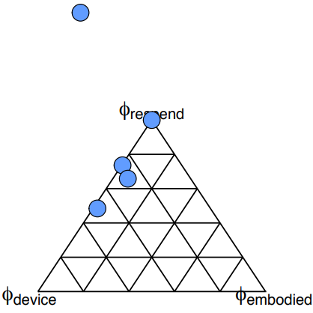
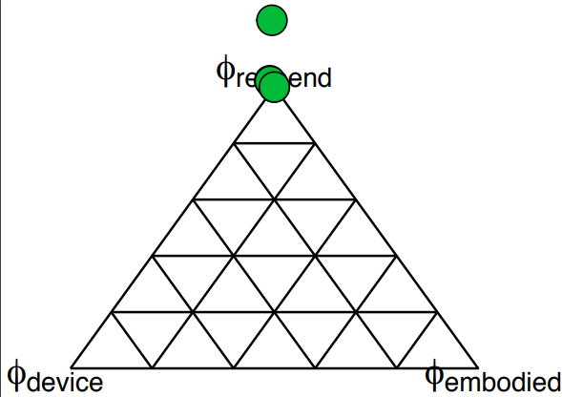
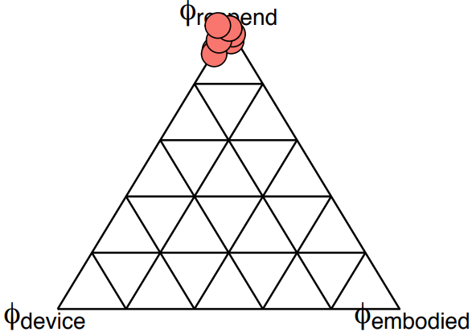
Economy-Wide Impacts
Hyperconservation:
Saves more energy than expected
Rebound:
Saves energy, but less than expected
Backfire:
Uses more energy than before
Notes:
The three ways we see rebound manifesting are as:
Cue 1: Hyperconservation: we saved more energy than expected
Cue 2: Rebound: when the device doesn’t save as much energy as predicted because of changes in behavior
Cue 3: Backfire: when the energy efficient device changes behavior so much that you actually use more energy than before
Note the nuance between rebound and backfire: in rebound you still save energy, just not as much as you expected. In backfire you use more energy than you did before making any changes
We’ll take a bit of a closer look at each case:
It’s interesting to see which devices fall into which categories for rebound
Heun’s notes 12/2:
Hyperconservation: “Saves more energy than expected.”
Rebound: “Saves energy, but less than expected.”
Backfire: “Uses more energy than before”
Remove “You” and “to”

Slide 29
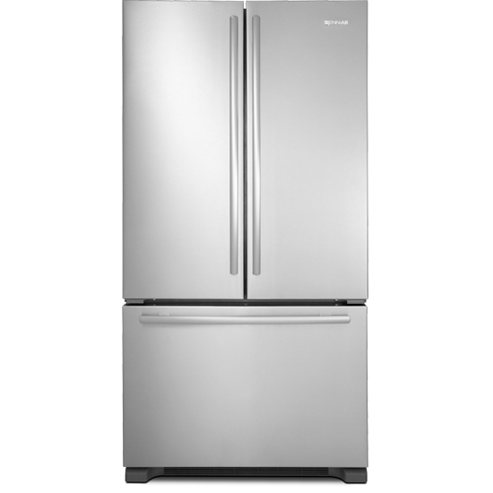
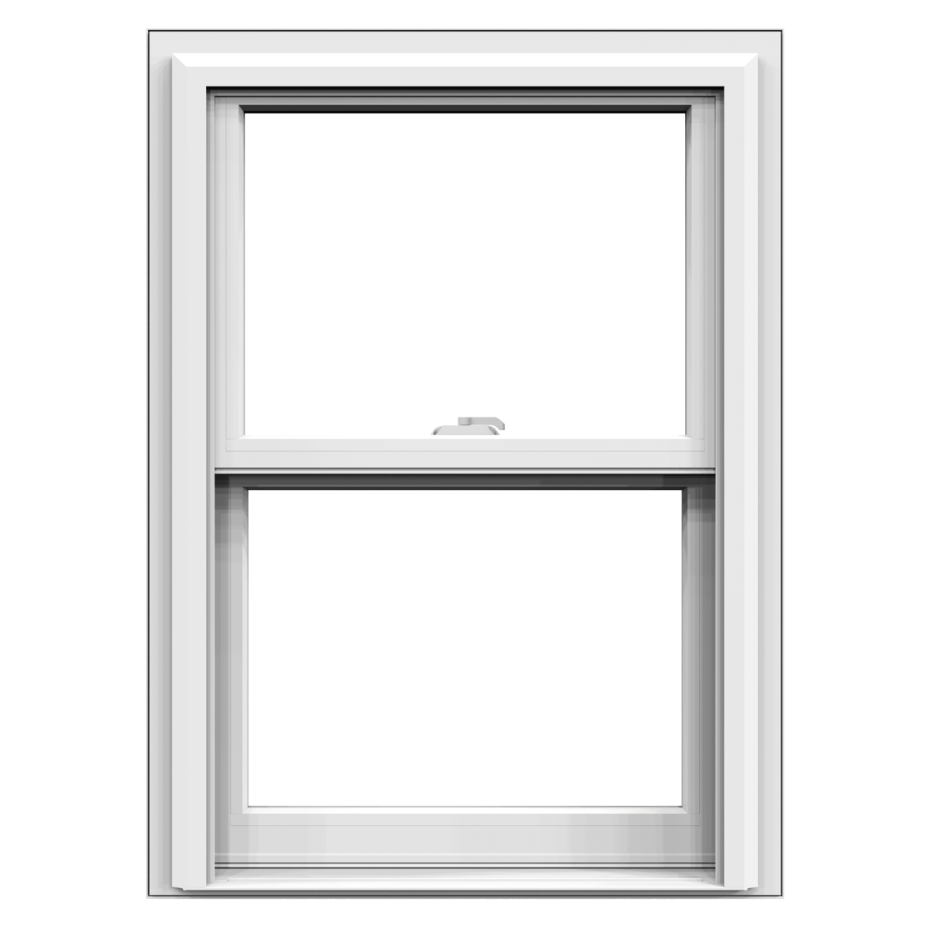
Hyperconservation
Notes:
These devices save more energy than anticipated: hyperconservation
Cue 1: There are a few points right on the vertex that stack on top of each other, where respending is nearly 100% of Re_EW
All are part of our ‘expensive’ devices
Cue 2: Computer servers
Cue 3: Three windows groups
Cue 4: Corolla to Prius
Cue 5: Refrigerators
Cue 6: Electric vehicle is an outlier because it has a negative device level rebound and a negative embodied energy rebound – but we’ll talk about that more later
But the cost of the device isn’t really what’s making respending dominate these cases
These devices are money sinks
In all cases the EE device is more expensive than the Base Case
Respending dominates, not because you’re spending more money but because you’re spending less money
Less money eaten up by and energy intense economy

Slide 30
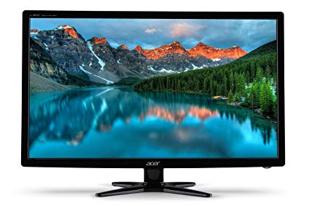
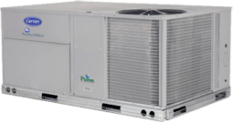
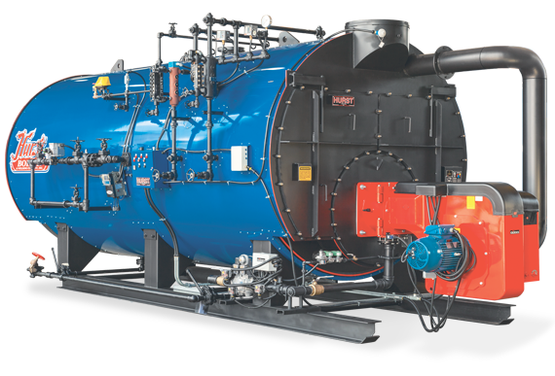
Rebound
Notes:
These devices save a bit less energy than anticipated (no devices had zero rebound): rebound effect
These are a range of ‘large’ and ‘small’ devices
Cue 1: Small devices
Computer monitors (small)
Smart power strips (small)
Cue 2: Larger devices
Boilers (large)
HVAC (large)
Gas to Hybrid (large)
Cue 3: These devices fall along the resepending and device level rebound line, all far from emobodied energy
These devices had higher device level rebound
Not guaranteed to be money sinks; costs are comparable from base to EE
Computer monitors are way out there because of a much lower embodied energy in EE case
Impacted by device and resepending rebound, lean slightly towards respending
Heun’s Notes:
Instead of bullet points with words – have pictures
Take the icon images for projects and make sure the difference is intelligible
Other comments:
The images could pop up over each other if they are individually too small – judgement call
The pictures could be schematics instead of actual images
Heun’s notes 12/2:
Need popups of devices you’re talking about (same for hyperconservation and backfire)
Put image near dot of each case you discuss (make it fade in and out)
Put a couple general images on the left

Slide 31
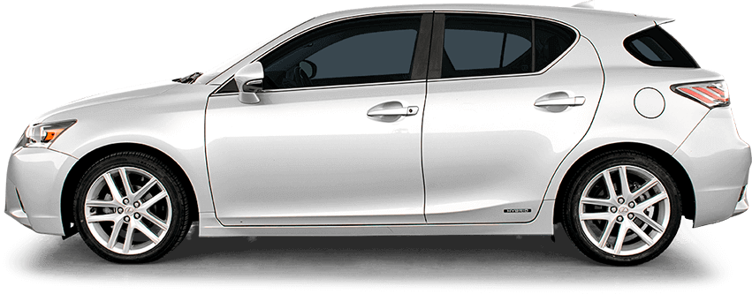
Backfire
Notes:
Economy wide, these devices use more energy than they save: some by a lot – backfire
Cue 1: Clearly dominated by respending
Cluster very tightly around the respending vertex with no real outliers
Cue 2: Most are smaller purchases, things you might by in your home
Low-flow shower heads
Motion sensor lighting
Smart power strips
LED lights
Cue 3: But some are larger purchases
Dryers
Two automobile cases
For backfire, respending dominates for the opposite reason as hyperconvservation
These are not money sinks, they are money savers for the consumer
Because of the MPC, consumers spend that money back in the economy and use more energy than before

Slide 32
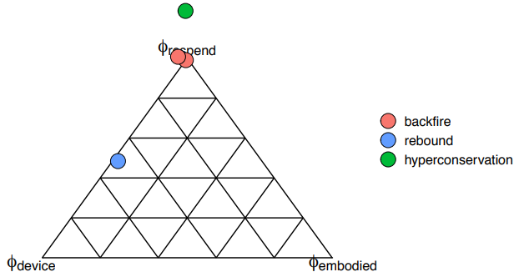
Autos Case Study
-54%
216%
643%
40%
Notes:
To understand in a bit more detail why a device might save energy, have rebound, or backfire we’re going to look at three cases of automobiles
Cue 1: One demonstrates hyperconservation: Corolla to Prius
Lies outside the graph because of a negative respending impact
Small device level rebound
Small increase in embodied energy
The Prius ends up being a money sink, so there’s less freed cash for the consumer to spend in the economy
Cue 2: One has positive rebound: Gas to Hybrid
Same vehicle,
Nearly 50/50 on device and respending impact
It saves energy, but it saves you a bit of money too
You use it more
Two devices that backfired – not changing the fuel source, only the way fuel is used; they have the same device level rebound of 6%
Cue 3: six cylinder to four cylinder is basically the same vehicle, just with a smaller engine which saves you money at the pump
Cue 4: Automatic to manual which is a different drive train and saves you money because it has better fuel economy
Both cases, the respending rebound accounts for nearly 100% of econ wide – 100% and 99% respectively
More money in your pocket is more money spent in the economy
So looking at this example, you can see why devices might fall in one type of rebound or another – and it mostly has to do with whether or not the device saves you money while you’re saving energy
But the values that we’ve just walked through only represent one specific economy, with an MPC of 95%
That means if I have an extra dollar to spend, there is a 95% chance that I will spend it
So we’ve done a sensitivity analysis to see how a changing MPC changes where our points fall
Heun’s notes 12/2:
“I never saved enough in fuel cost savings -> Prius was money sink -> respending dominated”
Match greens (text & dot)
Do other colors also (with eyedropper tool)

Slide 33
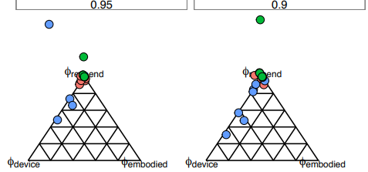
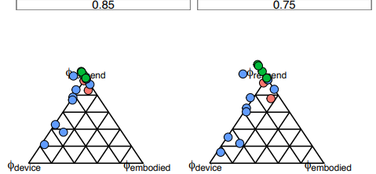
Sensitivity Analysis
MPC
Notes:
Because our results seemed so dependent on our respending values, we changed our parameters of k and MPC to change our respending values, from 0.75 to 0.95
MPC Cue 1:
Cue 1: For our MPC = 0.95 we already know quite a bit of detail about our data
Cue 2-4: As we decrease our MPC, we see the points do two things: change color and shift in location on the ternary graph
Our color change represents the value of economy wide rebound
Cue 5: There are more blue dots as MPC decreases
Devices that exhibited backfire before are now in the rebound category because dollar-savings isn’t being respent as quickly throughout the economy
As you know by now, the location on the graph indicates the composition of our economy wide rebound
Cue 6: Interestingly, though our points do move around quite a bit, they don’t cross the 20% embodied energy line
This means that regardless of our MPC, embodied energy has a relatively low contribution to our economy wide rebound
Cue 7: more impactful are our device level rebound and respending rebound, and their influence depends highly on MPC
We see device level rebound contributing more to economy wide rebound as MPC decreases
Our device level rebound isn’t changing, it’s just having more of an influence because our value for respending rebound is changing with MPC
Even though our points shift towards device level rebound, we still see points clustering around the respending vertex
Cue 8: Even in changing MPC we cannot discount the impact respending has on economy wide rebound.
Heun’s Notes 12/2:
Introduce what MPC is prior to this slide, likely in the respending slide.
MPC: don’t forget marginal part (a new dollar)
Other notes 12/2:
Missing slide number

Slide 34
How much energy does energy efficiency save?
?
Notes:
So we’re back to our big question, how much energy does energy efficiency save? And the answer seems to be ‘not as much as we might think.’
Saving energy at the device level doesn’t necessarily mean that we save energy as a society/economy
Points cluster toward respending
In fact, saving money as we save energy may mean that we use more energy than we did before
Depending on your intention with an energy-saving device, energy-efficiency devices may not be as effective as you want them to be
Cue 1: Which brings us to an interesting tension between energy efficiency and economic activity
Cue 2: We want to save energy to conserve finite resources on the one hand,
Cue 3: but an added incentive is saving money
Our research seems to suggest that saving money in energy efficiency might actually increase energy usage economy wide, so where does that leave us?
If you want to save money, there are a lot of little device changes you can make
Even with device level rebound, you might save money
But if you’re interested in saving energy, saving money might be sending you in the wrong direction
If you hope to reduce your consumption of finite energy resources and use natural resources sparingly and wisely, there are a few options to consider

Slide 35
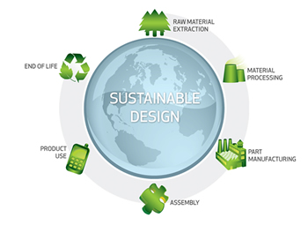
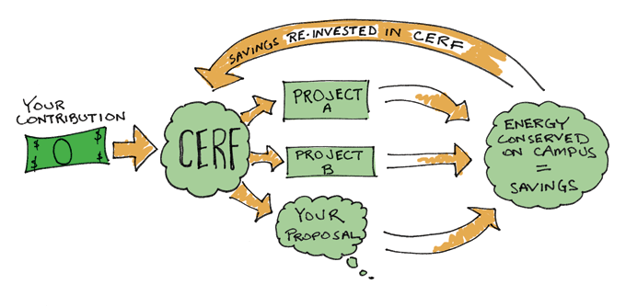
Mitigating Rebound
Device Level
Rebound
Embodied Energy
Rebound
Respending
Rebound
https://www.adazing.com/book-clipart/
http://www.solidworks.com/sustainability/sustainable-design-guide.htm
https://calvin.edu/support/energy/
Notes:
Image sources:
https://www.adazing.com/book-clipart/
http://www.solidworks.com/sustainability/sustainable-design-guide.htm
https://calvin.edu/support/energy/
We see different reasons for the economy-wide rebound falling out of the impacts of our three parameters
As we saw with a more in-depth examination of the three automobile cases, every type of energy-saving device has a different composition of these three parameters
For each of these three in question, there are some possible ways to consider mitigating the parameter’s impact on economy-wide rebound
Cue 1: Education
Device level rebound tends to be a function of human behavioral changes
Careful education about rebound and energy efficiency could help mitigate the behavior changes
Cue 2: Careful engineering and design
When we think about embodied energy, we think about the parts and pieces that come together to make a device
Careful engineering and design can help us use less raw materials – maybe recycled?
Careful engineering and design can help us manufacture more efficiently and using less energy
Careful material sourcing can help us reduce energy usage in transportation and distribution of energy efficient devices
Cue 3: Revolving funds
But respending is the doozy, it’s the one which dominates the composition of economy wide rebound
We could stop respending rebound by just not respending
More realistically we may be able to mitigate the impact of respending rebound by spending money-saved on more energy saving devices
Now wait, if I’m still respending that money, aren’t I still contributing to respending rebound because of the energy intensity of the economy?
Well, yes. But energy intensity, sort of like embodied energy, depends on where you spend your money
Because energy-efficiency devices do indeed save energy, the energy intensity of that sector of the economy is, presumably, less than the economy as a whole
Because our research shows that respending has the most impact on economy wide rebound, revolving funds may be an effective way to mitigate economy wide rebound

Slide 36
How much energy does energy efficiency save?
Device
Embodied
Re_{EW}
Respending
Notes:
When we looked at our main question, we didn’t know which of these mechanisms would be most impactful. But now we know…
The short version is it depends: it’s not quite as easy a just buying an energy efficient device
Cue 1: But the device will save me energy at the device level if I use it the same.
Cue 2: When I change my behavior, device level rebound kicks in. Behavior change means I save less energy with the device than I expected to.
Cue 3: Because when I do convert my vehicle to something more energy efficient, it has some embodied energy implications to my new device – even though our research shows it’s mostly negligible, it’s still there
Cue 4: But the biggest factor seems to be how my finances are impact by energy efficiency
Cue 5: Whether my device is a money sink or a money saver, respending rebound kicks in and has a big impact on our economy wide rebound
Cue 6: These three factors work together to impact energy usage at the macro, economy-wide level
Together they influence economy wide rebound, and further research could tell us more about how we could use these three parameters to limit our economy-wide consumption of finite resources
Heun’s notes 12/2:
Device->embodied->respending (order should match the rest of the presentation)
Change green for respending to teal perhaps? (right now it looks like hyperconservation)
If we need to trim things to reduce the length of the presentation, reduce the T&T case study section
If we use the graphic in the lower left corner, then stack all of these components vertically to match the graphic style
Other notes 12/2:
Perhaps use this graphic earlier in the presentation (it’s a great graphic)
Remove the “Re”s -> just say embodied, device, respend, etc.
Perhaps increase the size of the respending squircle since it’s actually the biggest contributor

Slide 37
Further Questions
Does education actually have an impact on device level rebound?
Are there ways to design products that reduce device level rebound?
How do you design products to minimize embodied energy rebound?
How do energy revolving funds influence economy wide rebound?
Are there ways to implement revolving funds at a community level?
Are there policy changes that could impact economy wide rebound?
Does the size of the economy effect rebound?
Notes:
The status of our research right now leaves us with more questions yet to ask and answer: Questions like how does education impact device level rebound or how much of an impact do revolving funds have. These are new opportunities to think critically about how we interact with the planet.
These types of questions and critical analysis that we’re called to as Christians,
It takes some doing, but could be a step in the right direction as we seek to conserve our finite natural resources and glorify God.
Even as we think about ways that we can expand on this research, we want to take a minute and recognize some of the people that made this research possible

Slide 38
Acknowledgements
Dr. Paul Brockway from the University of Leeds, UK
Calvin Energy Recovery Fund (CERF)
Kyle Bratt from the Window Center in Holland, MI
Scott Stegenga from West Michigan Heating and Cooling
Keith Van Kooten and Larry VanHoe from Calvin Facilities
Travis Vander Kolk from Hurst Boiler and Welding Co.
Gary Rutman from Burnham Commercial Boilers
Mike Troupos from Foresight Energy Management

Slide 39
Questions

