Slide 1
Net-Zero House Study
Engineering 333 Class Project
Senior Mechanical Engineering Students
12/02/2014

Slide 2
What would it take to make a home in Grand Rapids Net-Zero?
Background | Assess | Reduce | Generate | Offset | Results

Slide 3
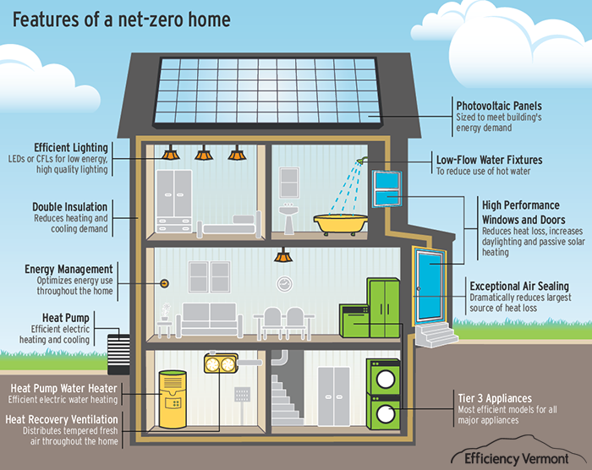
What is Net-Zero?
https://www.efficiencyvermont.com/sf-images/default-source/bbd/residential_ netzero_graphic_final_cs5_largetext-01DAC6DAB02C1A.png?sfvrsn=2
Background | Assess | Reduce | Generate | Offset | Results
Notes:
A Net-Zero Home produces as much energy as it consumes in a calendar year

Slide 4
Historical US Energy Consumption Percentage by Sector
Figure 1. Historical US Energy Consumption Percentage by Sector.
http://www.eia.gov/totalenergy/data/annual/showtext.cfm?t=ptb0201a
Background | Assess | Reduce | Generate | Offset | Results

Slide 5
Why investigate this?
God spoke: “Let us make human beings in our image, make them reflecting our nature so they can be responsible for the fish in the sea, the birds in the air, the cattle, and yes, Earth itself, and every animal that moves on the face of Earth.”
- Genesis 1:26
Background | Assess | Reduce | Generate | Offset | Results

Slide 6
DeMaagd
Koetje
Evenhouse
Heffner
Cooper
Boer
Newhof
Affholter
Background | Assess | Reduce | Generate | Offset | Results

Slide 7
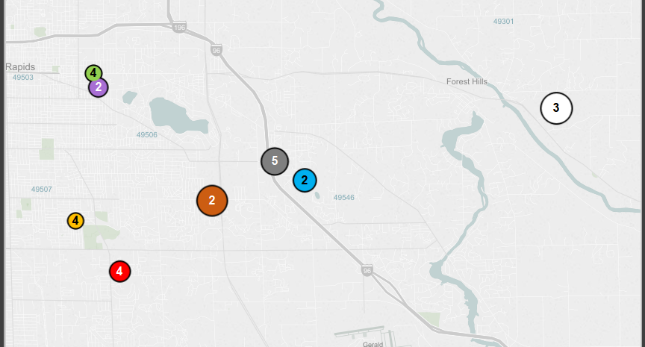
Reeds Lake
Calvin College
Affholter
Boer
Cooper
DeMaagd
Evenhouse
Heffner
Koetje
Newhof
1,250 ft²
2,000 ft²
3,000 ft²
E Beltline
4,000 ft²
Background | Assess | Reduce | Generate | Offset | Results

Slide 8
Net-Zero Implementation Process
Assess
Reduce
Generate
Offset
Background | Assess | Reduce | Generate | Offset | Results

Slide 9
High Energy Consumption
$5
Low Energy Consumption
$10
Background | Assess | Reduce | Generate | Offset | Results

Slide 10
Assess: Energy Audits
Affholter
Percentage of Total Electricity Usage
Background | Assess | Reduce | Generate | Offset | Results
Notes:
Energy Audits are the prologue to net zero. They map out where a house is and they point towards feasible options for a house.
An energy audit is a walkthrough of the house that catalogs what every energy user is, and how much energy they use.
Transition #1.
Here, we see the audit results of the Affholter House.
Appliances take up a ton of energy
Most appliances are in the kitchen
Lighting is a significant factor in energy usage
Entertainment energy spending is minimal, so lifestyle changes may not be a high-value option.

Slide 11
Background | Assess | Reduce | Generate | Offset | Results

Slide 12
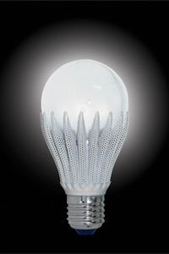
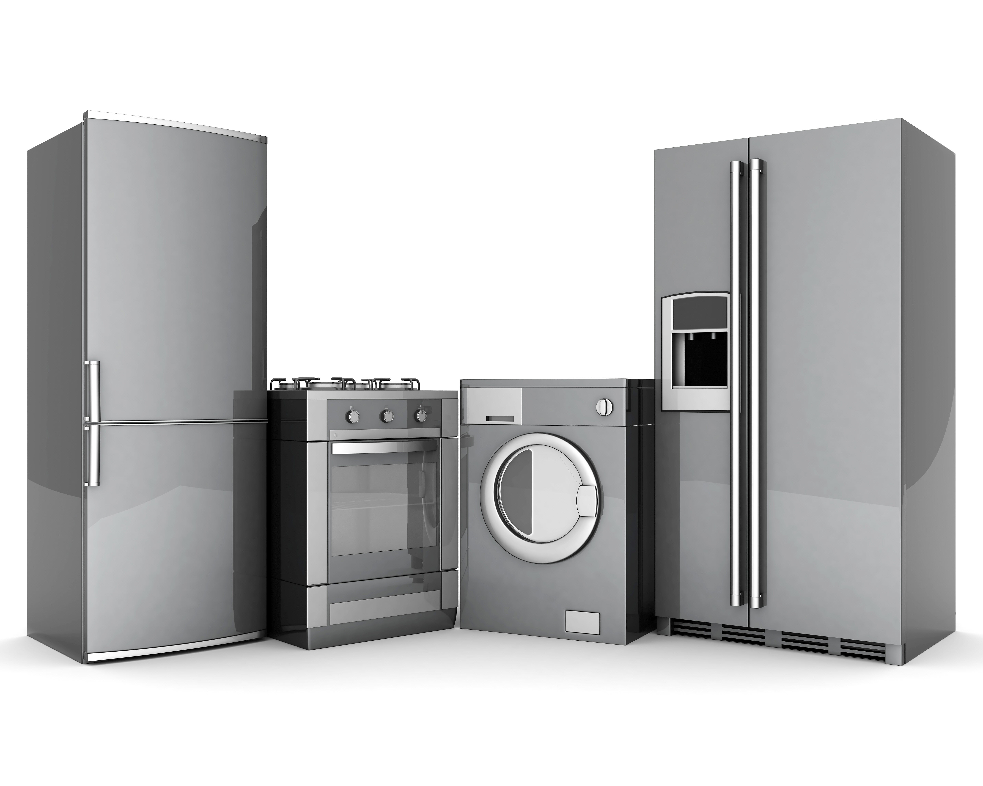
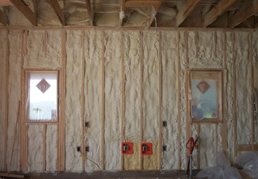
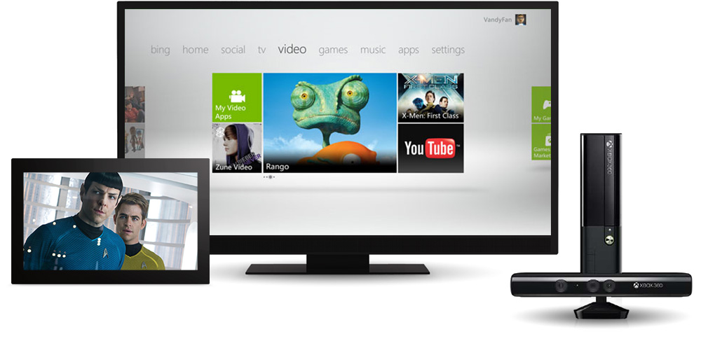
Energy Reduction
Lighting
Appliances
Insulation
Lifestyle Changes
http://s.hswstatic.com/gif/led-light-bulb-1.jpg
http://dakselfstorage.com/wp-content/uploads/2014/10/kicthen-appliance-storage.jpg
http://nesbuildingsolutions.com/wp-content/uploads/2013/01/spray-foam-wall-insulation-1.gif
http://compass.xbox.com/assets/3a/17/3a17ef9b-e017-4282-9f25-6b7e35b0c27a.jpg?n=ui-xbox-360-cle-video-xbox-video-1000x487.jpg
Background | Assess | Reduce | Generate | Offset | Results

Slide 13
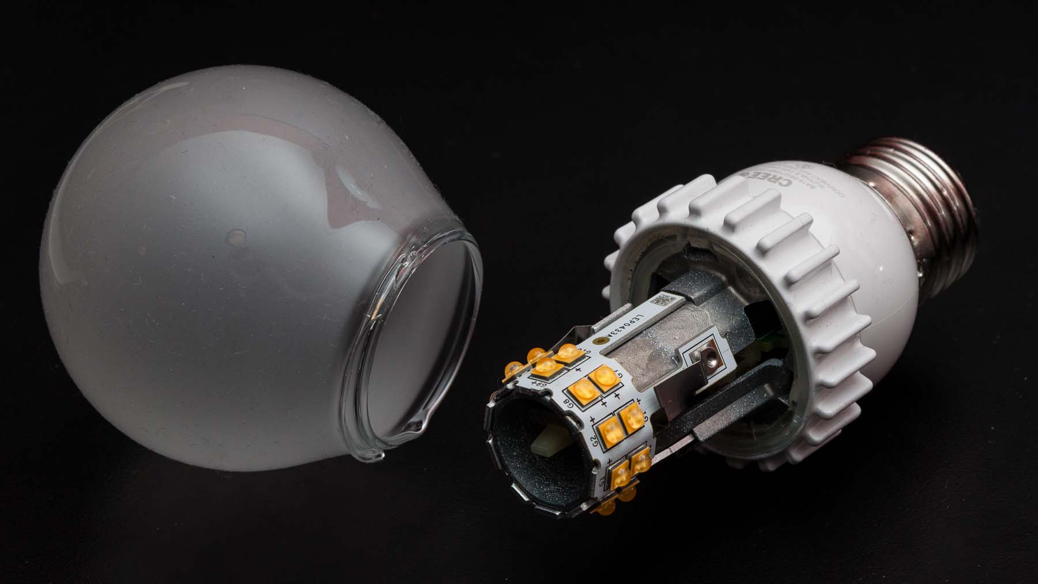
LED Lighting – Cooper House
Cooper
http://www.marco.org/media/2013/09/cree-led-flaw.jpg
http://assets.inhabitat.com/wp-content/blogs.dir/1/files/2011/08/Zimbabwe-CLF-bulb-exchange-3-537x402.jpg
Background | Assess | Reduce | Generate | Offset | Results
Notes:
5826.6 kW-hr / year​
$700 / year

Slide 14
Background | Assess | Reduce | Generate | Offset | Results

Slide 15
$957.5
Background | Assess | Reduce | Generate | Offset | Results

Slide 16
$400
$957.5
$195
$48
$1,395
Background | Assess | Reduce | Generate | Offset | Results

Slide 17
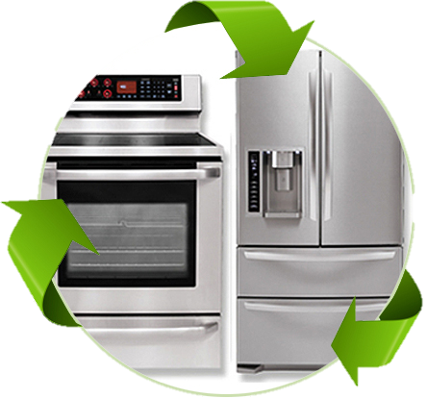
Appliances – DeMaagd House
DeMaagd
http://www.homeenergytune-ups.com/wp-content/uploads/2013/11/energyefficient.jpg
Background | Assess | Reduce | Generate | Offset | Results
Notes:
450 kW-hr / year​
$54 / year

Slide 18
Background | Assess | Reduce | Generate | Offset | Results

Slide 19
$1,400
Background | Assess | Reduce | Generate | Offset | Results

Slide 20
$7,100
$2,000
$4,128
$1,520
$2,634
$2,710
Background | Assess | Reduce | Generate | Offset | Results

Slide 21
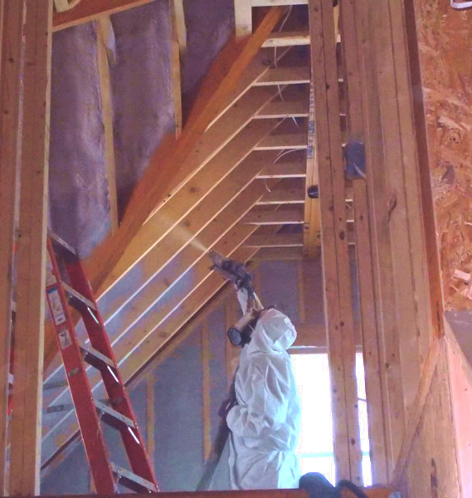
Insulation – Koetje House
Koetje
http://iandsinsulation.com/images/TomSpraying.jpg
Background | Assess | Reduce | Generate | Offset | Results
Notes:
Previously no wall insulation
361 therms/ year​savings
$380 / year savings

Slide 22
Background | Assess | Reduce | Generate | Offset | Results

Slide 23
$750
Background | Assess | Reduce | Generate | Offset | Results

Slide 24
$610
$1,730
$750
$10,700
Background | Assess | Reduce | Generate | Offset | Results

Slide 25
Lifestyle Changes - Boer House
Boer
http://www.bose.com.hk/upload/products/videowave/videowave_bl_lg.jpg
Background | Assess | Reduce | Generate | Offset | Results
Notes:
265 kW-hr / year​
$30 / year

Slide 26
Background | Assess | Reduce | Generate | Offset | Results

Slide 27
$0
Background | Assess | Reduce | Generate | Offset | Results

Slide 28
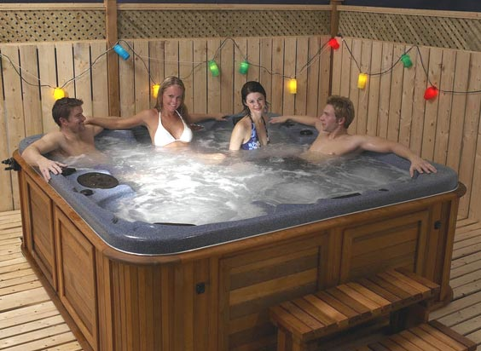
$0
$0
http://www.arcticspas.com/
Background | Assess | Reduce | Generate | Offset | Results

Slide 29
Background | Assess | Reduce | Generate | Offset | Results

Slide 30
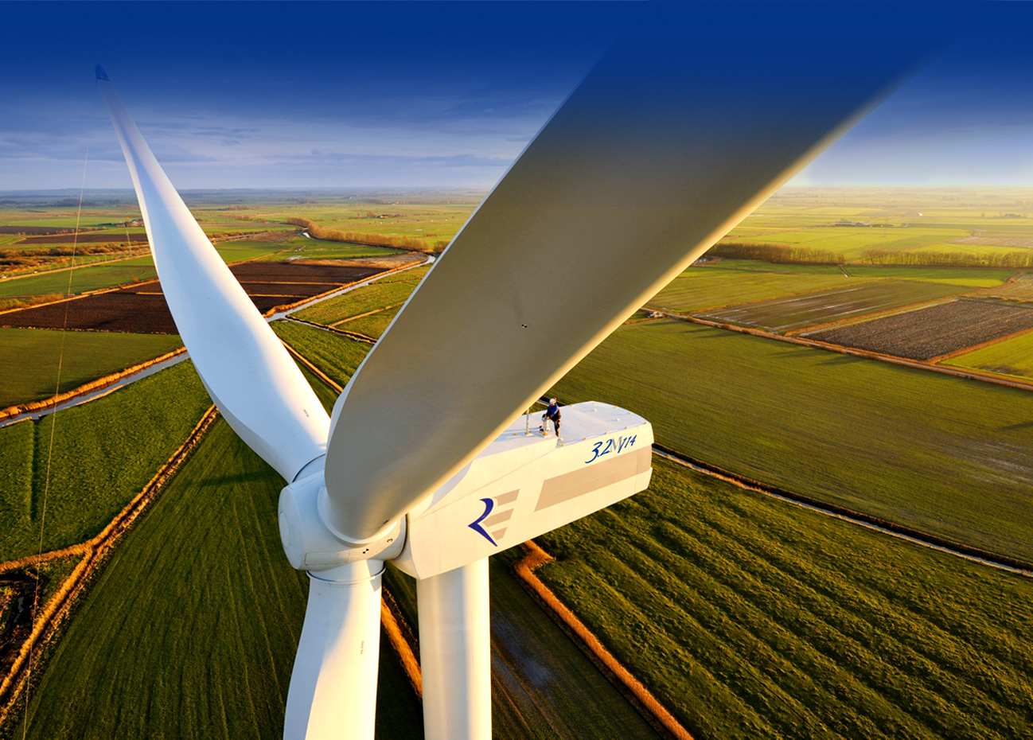
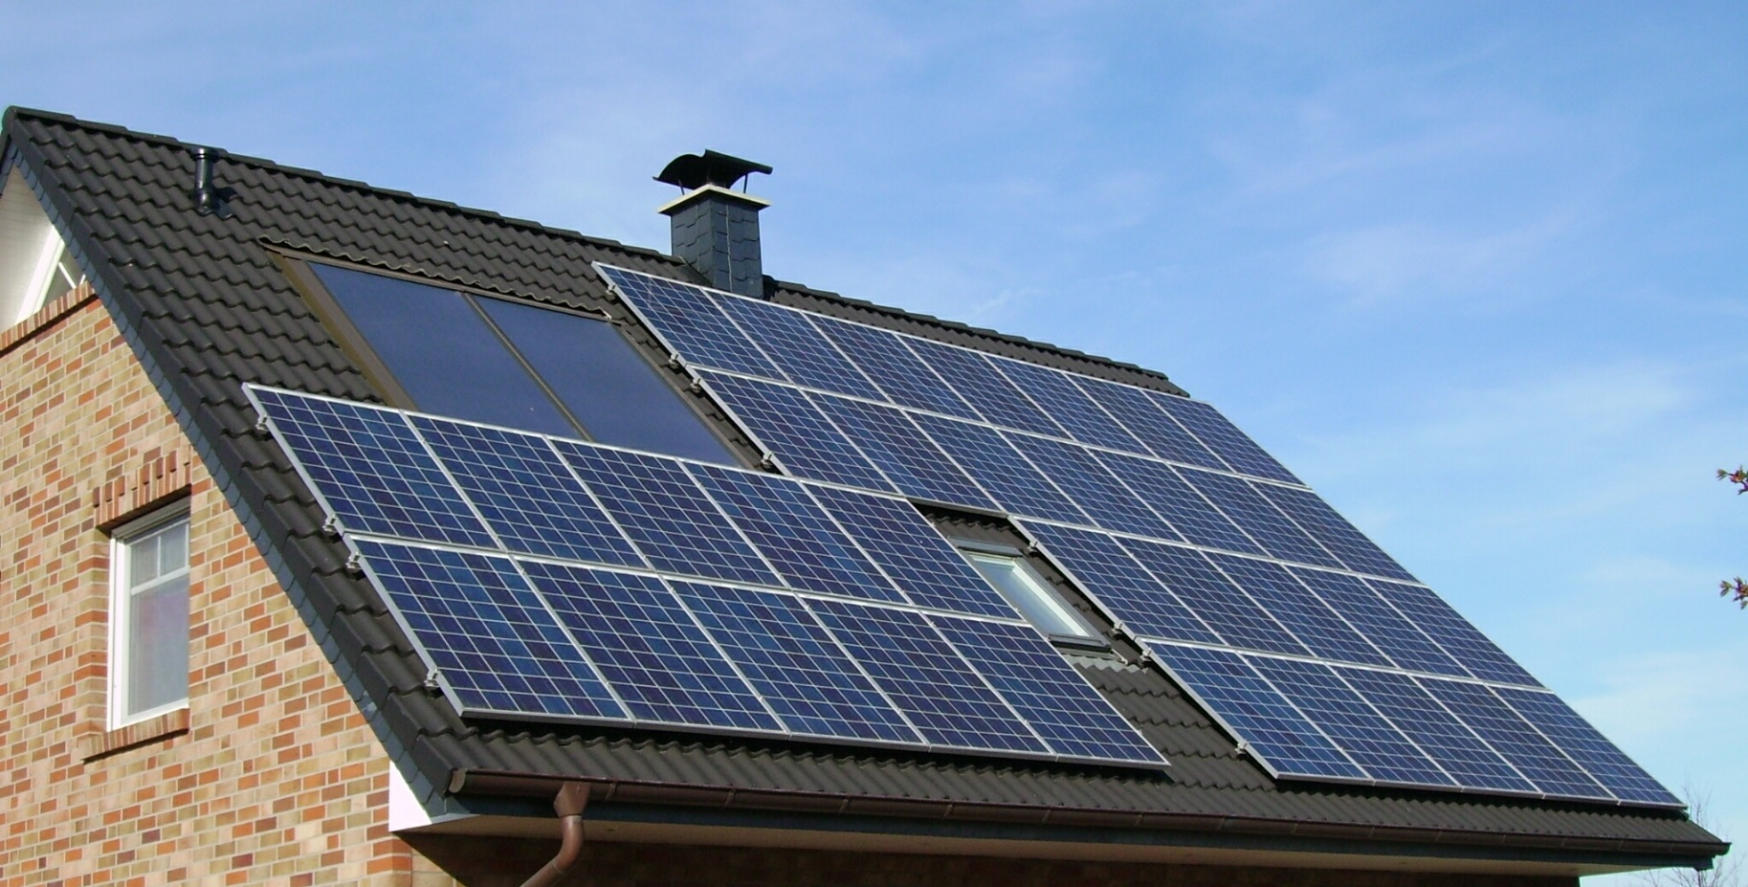
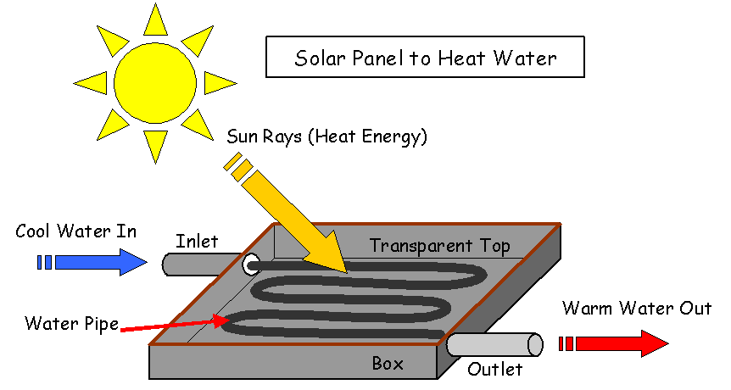
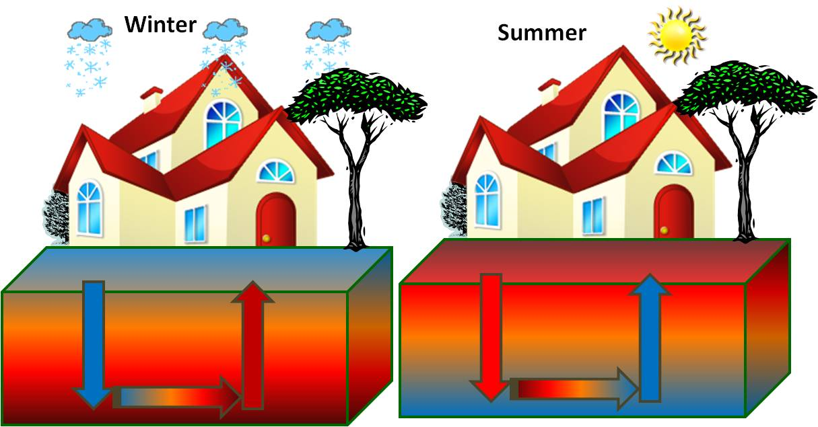
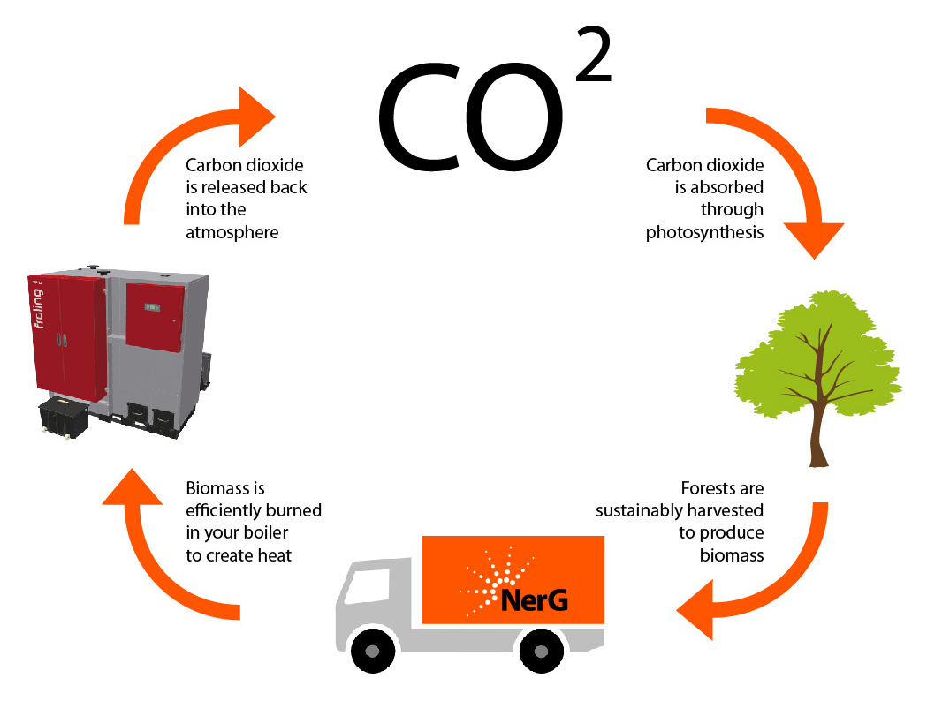
Energy Generation
http://www.triplepundit.com/2014/01/wind-energy-industry-receive-tax-credits/
http://commons.wikimedia.org/wiki/File:Solar_panels_on_a_roof.jpg
http://www.theecoambassador.com/Geothermalenergy.html
http://www.makeitsolar.com/solar-energy-information/02-solar-energy.htm
http://www.nerg.co.uk/NerG/biomass-heating/
Background | Assess | Reduce | Generate | Offset | Results

Slide 31
Geothermal - Affholter House
Affholter
http://www.esipowercorp.com/Portals/139609/images/Vertical_Loop.jpg
Background | Assess | Reduce | Generate | Offset | Results
Notes:
Space Confinement issues
Horizontal Loop is inexpensive if home has the space

Slide 32
Background | Assess | Reduce | Generate | Offset | Results

Slide 33
$18,200
Background | Assess | Reduce | Generate | Offset | Results

Slide 34
$25,000
$18,200
$36,000
$35,000
$35,000
$14,240
Background | Assess | Reduce | Generate | Offset | Results

Slide 35
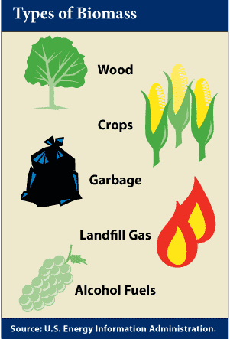
Biomass - Evenhouse
Evenhouse
Background | Assess | Reduce | Generate | Offset | Results
Notes:
Using biomass energy is the same concept applied when using corn ethonol as car fuel. Biomass energy works by “growing energy as fast as you use it.”
The Even house home was a prime opportunity to explore biomass heating

Slide 36
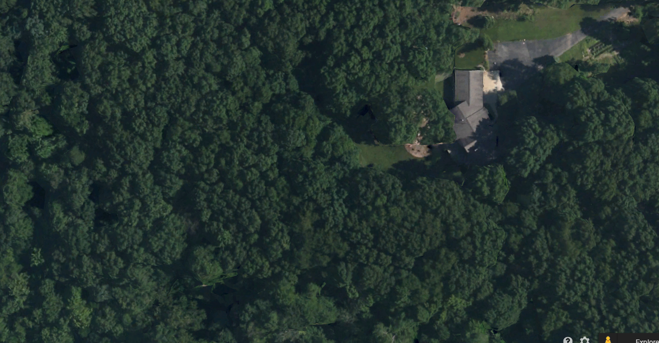
Reeds Lake
Calvin College
Affholter
Boer
Cooper
DeMaagd
Evenhouse
Heffner
Koetje
Newhof
1,250 ft²
2,000 ft²
3,000 ft²
E Beltline
4,000 ft²
Background | Assess | Reduce | Generate | Offset | Results
Notes:
The Evenhouse home is further outside of the city as the other homes and is surrounded by several acres of woodlands. This gives enough land to sustainably grow and burn wood

Slide 37
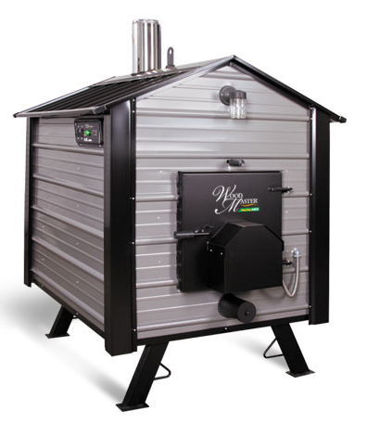
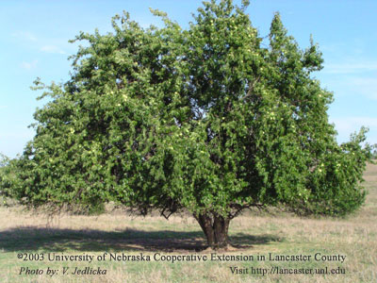
Biomass
Evenhouse
http://www.woodmaster.com/woodfurnaces_4400.php
Background | Assess | Reduce | Generate | Offset | Results
Notes:
Concept: Grow Osage Orange to burn in a wood burner. Develop a wood plot which will sustainably grow wood, including a fallow plot.

Slide 38
Background | Assess | Reduce | Generate | Offset | Results

Slide 39
$12,520
Background | Assess | Reduce | Generate | Offset | Results

Slide 40
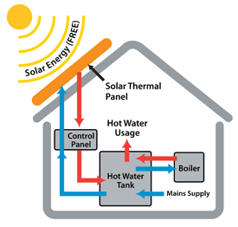
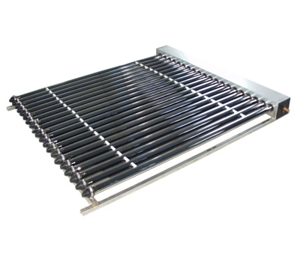
Solar Heat - Heffner
57 Therms / year-panel
Heffner
http://genesisenergysolutions.com/energy-solutions/solar-thermal
http://www.climatetechwiki.org/technology/solar-heating
Background | Assess | Reduce | Generate | Offset | Results
Notes:
Using biomass energy is the same concept applied when using corn ethonol as car fuel. Biomass energy works by “growing energy as fast as you use it.”
The Even house home was a prime opportunity to explore biomass heating

Slide 41
Background | Assess | Reduce | Generate | Offset | Results

Slide 42
$6,300
Background | Assess | Reduce | Generate | Offset | Results

Slide 43
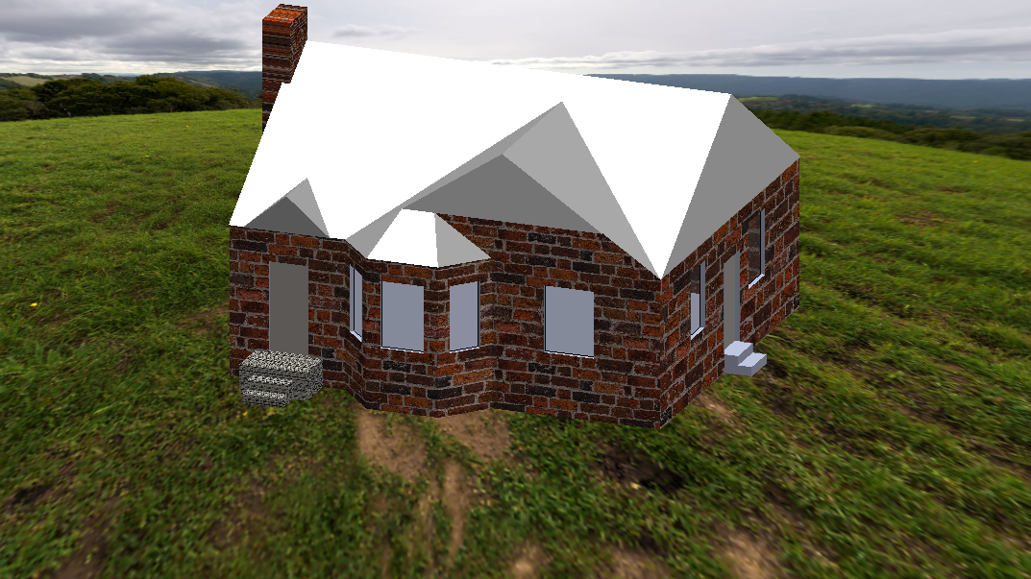
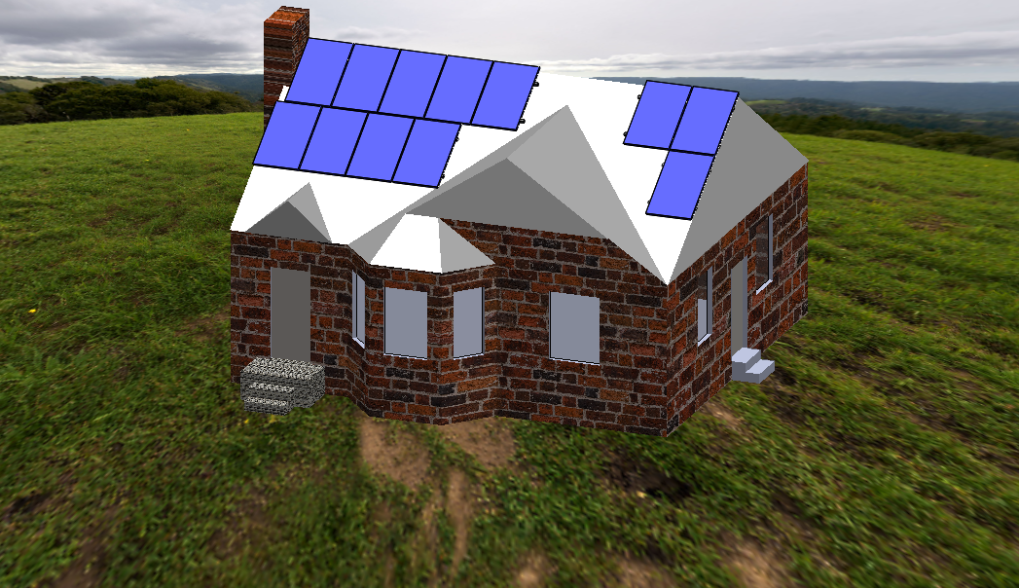
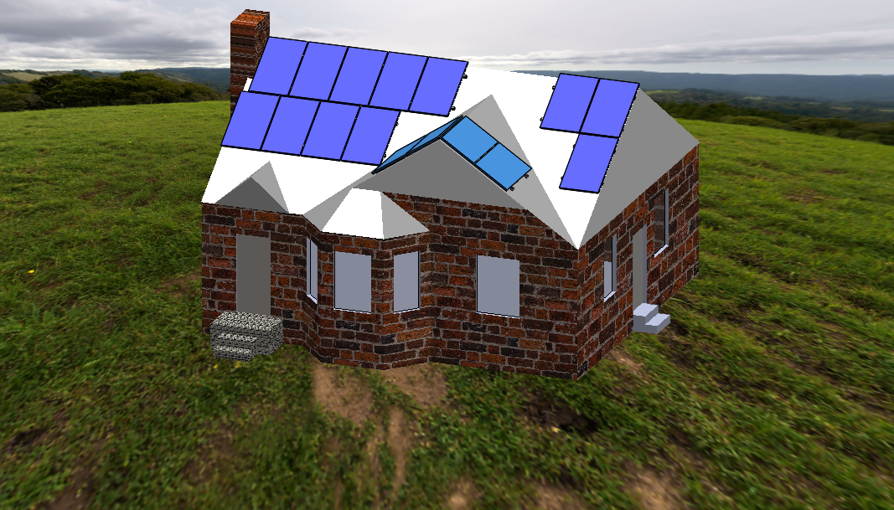
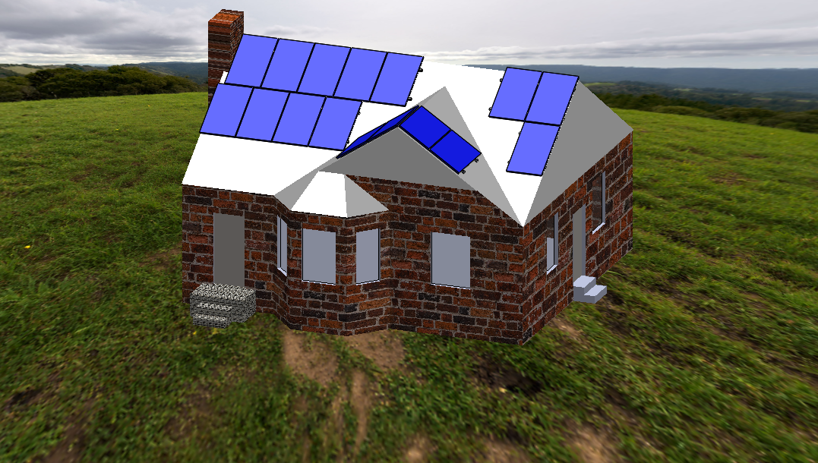
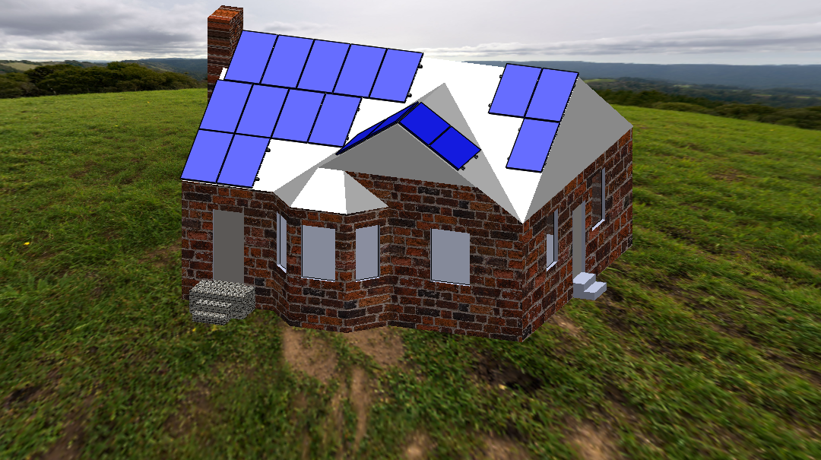
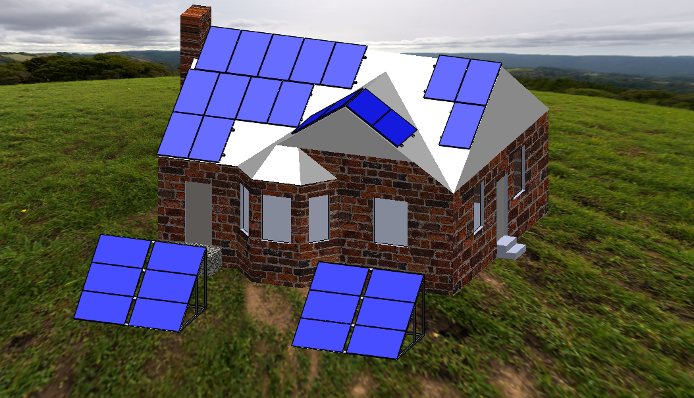
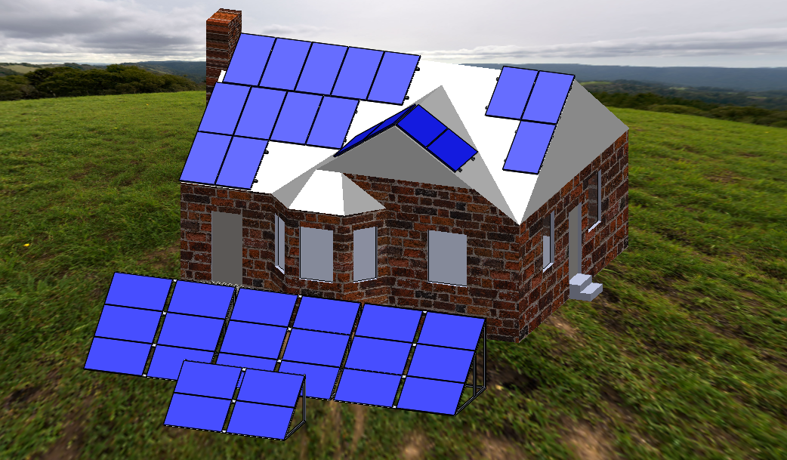
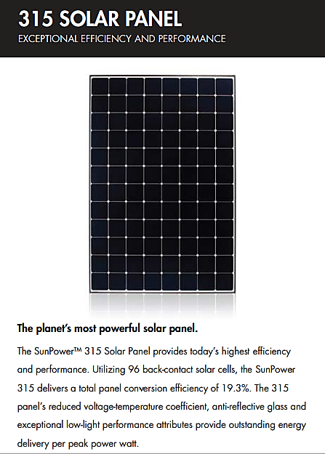
Solar PV
DeMaagd
Background | Assess | Reduce | Generate | Offset | Results
Notes:
Solar Panels

Slide 44
Background | Assess | Reduce | Generate | Offset | Results

Slide 45
$26,840
Background | Assess | Reduce | Generate | Offset | Results

Slide 46
$12,000
$94,780
$37,200
$32,190
$26,840
$32,200
$28,310
Background | Assess | Reduce | Generate | Offset | Results

Slide 47
Background | Assess | Reduce | Generate | Offset | Results
Notes:
Remove all homes which have achieved net zero

Slide 48
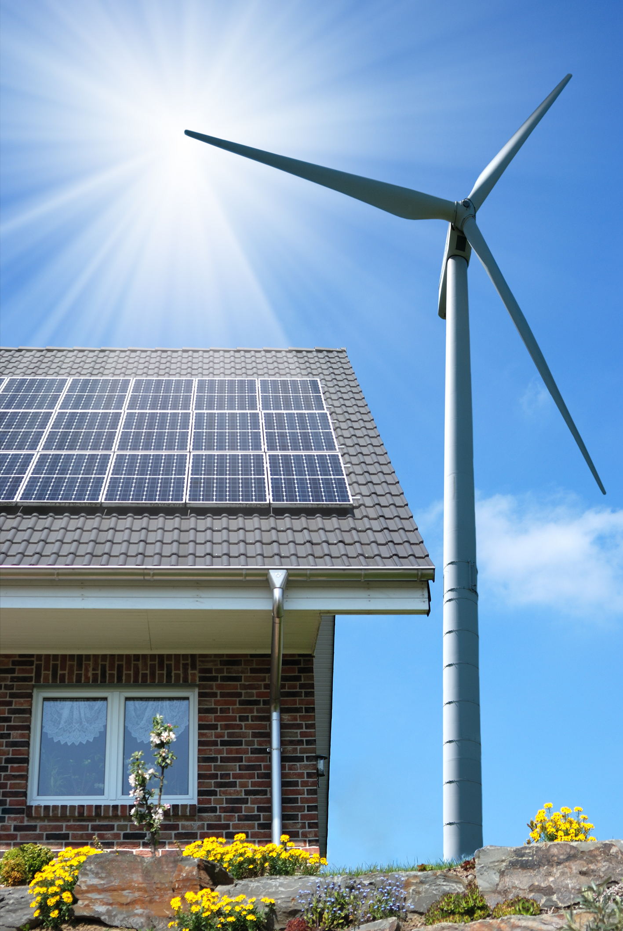
Wind
Newhof
http://cleantechnica.com/2014/04/21/real-innovation-wind-energy/
http://windturbineshome.net/
Background | Assess | Reduce | Generate | Offset | Results

Slide 49
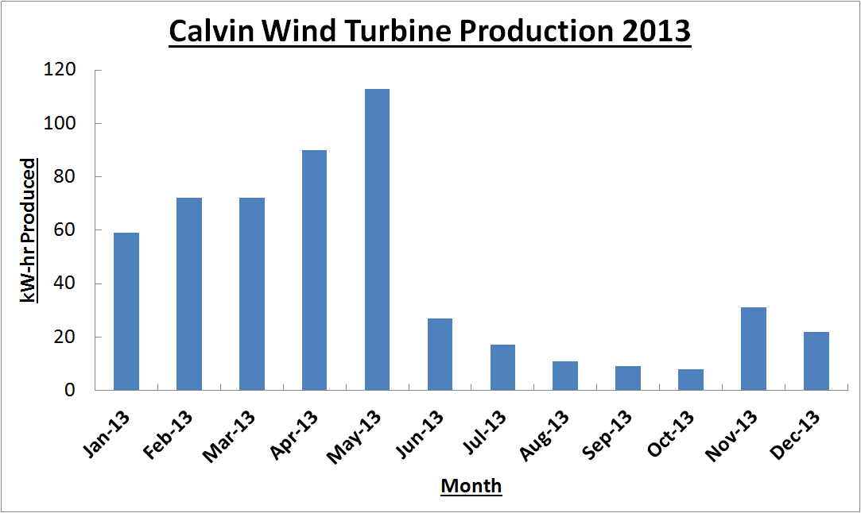
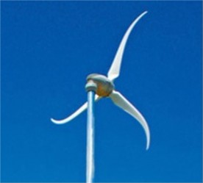
Cost GRAPH
http://www.calvin.edu/academic/engineering/Renewable_Energy_org/project/turbine.html
Background | Assess | Reduce | Generate | Offset | Results

Slide 50
Background | Assess | Reduce | Generate | Offset | Results
Notes:
Remove all homes which have achieved net zero

Slide 51
$34,000
Background | Assess | Reduce | Generate | Offset | Results

Slide 52
Background | Assess | Reduce | Generate | Offset | Results

Slide 53
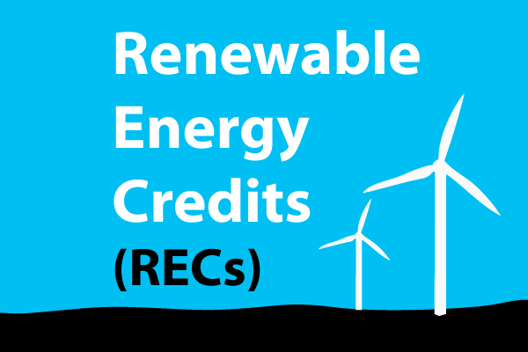
Offset
Cooper
DeMaagd
www.better-world-energy.com
Background | Assess | Reduce | Generate | Offset | Results
Notes:
Options:
Buy credits
Exchange energy
-Both produce enough to exchange energy

Slide 54
Background | Assess | Reduce | Generate | Offset | Results

Slide 55
Background | Assess | Reduce | Generate | Offset | Results

Slide 56
What did we learn?
Background | Assess | Reduce | Generate | Offset | Results
Notes:
All points are going to spoken. No Slides needed.
What worked?
- Solar panels are a great way to generate electricity. The payback period for grid-connected panels is now less than the life of the panels, which makes them viable.
- Reducing electricity and gas usage can be done. Especially electricity.
What didn’t work?
- Wind power is not a viable option in GR due to low wind speeds and regulations against height of wind turbines.
What unique / unexpected challenge did you face?
- A lack of environmental resources (space).
- Roof space
- Yard space for geothermal
- Sunlight is inconsistent in snowy climates, no reliable PV generation in the winter.
Need bakcup electrical with Solar water heaters.
What’re the main takeaways from the project?
- Becoming net zero is very expensive today.
- A mixture of generation and reduction technologies is required.
- Reducing energy use can be done relatively inexpensive. Esp. Efficient lighting
- Insulation is more expensive, but pays back quickly and significantly reduces natural gas use.
Other comments / insights?
- Using solar and wind for energy production is intermittent. Grid connection is essential.
- Eliminating natural gas usage is a costly process with a long payback period due to the low price of natural gas today.
- Getting to net-zero has slightly less than 30-yr simple payback.

Slide 57
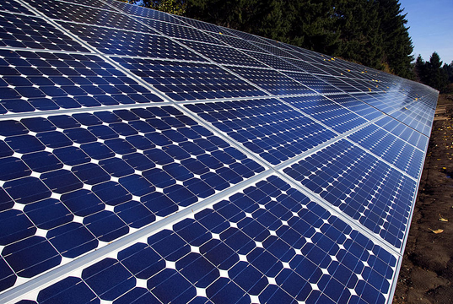
What Worked?
http://inhabitat.com/new-bio-solar-panels-are-made-with-cotton-and-castor-beans/
Background | Assess | Reduce | Generate | Offset | Results
Notes:
All points are going to spoken. No Slides needed.
What worked?
- Solar panels are a great way to generate electricity. The payback period for grid-connected panels is now less than the life of the panels, which makes them viable.
- Reducing electricity and gas usage can be done. Especially electricity.
What didn’t work?
- Wind power is not a viable option in GR due to low wind speeds and regulations against height of wind turbines.
What unique / unexpected challenge did you face?
- A lack of environmental resources (space).
- Roof space
- Yard space for geothermal
- Sunlight is inconsistent in snowy climates, no reliable PV generation in the winter.
Need bakcup electrical with Solar water heaters.
What’re the main takeaways from the project?
- Becoming net zero is very expensive today.
- A mixture of generation and reduction technologies is required.
- Reducing energy use can be done relatively inexpensive. Esp. Efficient lighting
- Insulation is more expensive, but pays back quickly and significantly reduces natural gas use.
Other comments / insights?
- Using solar and wind for energy production is intermittent. Grid connection is essential.
- Eliminating natural gas usage is a costly process with a long payback period due to the low price of natural gas today.
- Getting to net-zero has slightly less than 30-yr simple payback.

Slide 58
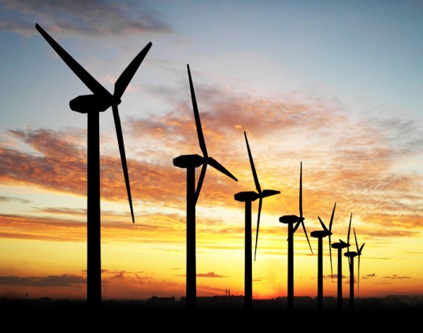
What Did Not Work?
http://inhabitat.com/bladeless-wind-turbine-design-is-for-the-birds-literally/
Background | Assess | Reduce | Generate | Offset | Results
Notes:
All points are going to spoken. No Slides needed.
What worked?
- Solar panels are a great way to generate electricity. The payback period for grid-connected panels is now less than the life of the panels, which makes them viable.
- Reducing electricity and gas usage can be done. Especially electricity.
What didn’t work?
- Wind power is not a viable option in GR due to low wind speeds and regulations against height of wind turbines.
What unique / unexpected challenge did you face?
- A lack of environmental resources (space).
- Roof space
- Yard space for geothermal
- Sunlight is inconsistent in snowy climates, no reliable PV generation in the winter.
Need bakcup electrical with Solar water heaters.
What’re the main takeaways from the project?
- Becoming net zero is very expensive today.
- A mixture of generation and reduction technologies is required.
- Reducing energy use can be done relatively inexpensive. Esp. Efficient lighting
- Insulation is more expensive, but pays back quickly and significantly reduces natural gas use.
Other comments / insights?
- Using solar and wind for energy production is intermittent. Grid connection is essential.
- Eliminating natural gas usage is a costly process with a long payback period due to the low price of natural gas today.
- Getting to net-zero has slightly less than 30-yr simple payback.

Slide 59
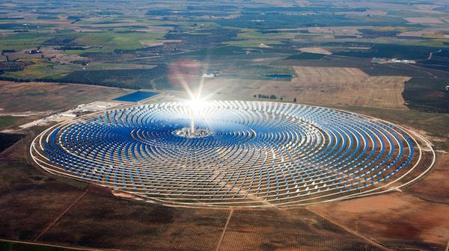
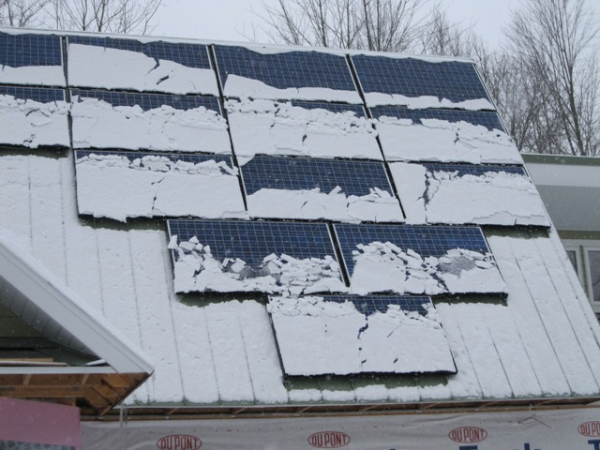
Challenges
http://news.nationalgeographic.com/news/energy/2012/02/pictures/120228-spain-solar-energy/
http://www.brainright.com/ourhouse/Construction/SolarElectric/
Background | Assess | Reduce | Generate | Offset | Results
Notes:
All points are going to spoken. No Slides needed.
What worked?
- Solar panels are a great way to generate electricity. The payback period for grid-connected panels is now less than the life of the panels, which makes them viable.
- Reducing electricity and gas usage can be done. Especially electricity.
What didn’t work?
- Wind power is not a viable option in GR due to low wind speeds and regulations against height of wind turbines.
What unique / unexpected challenge did you face?
- A lack of environmental resources (space).
- Roof space
- Yard space for geothermal
- Sunlight is inconsistent in snowy climates, no reliable PV generation in the winter.
Need bakcup electrical with Solar water heaters.
What’re the main takeaways from the project?
- Becoming net zero is very expensive today.
- A mixture of generation and reduction technologies is required.
- Reducing energy use can be done relatively inexpensive. Esp. Efficient lighting
- Insulation is more expensive, but pays back quickly and significantly reduces natural gas use.
Other comments / insights?
- Using solar and wind for energy production is intermittent. Grid connection is essential.
- Eliminating natural gas usage is a costly process with a long payback period due to the low price of natural gas today.
- Getting to net-zero has slightly less than 30-yr simple payback.

Slide 60
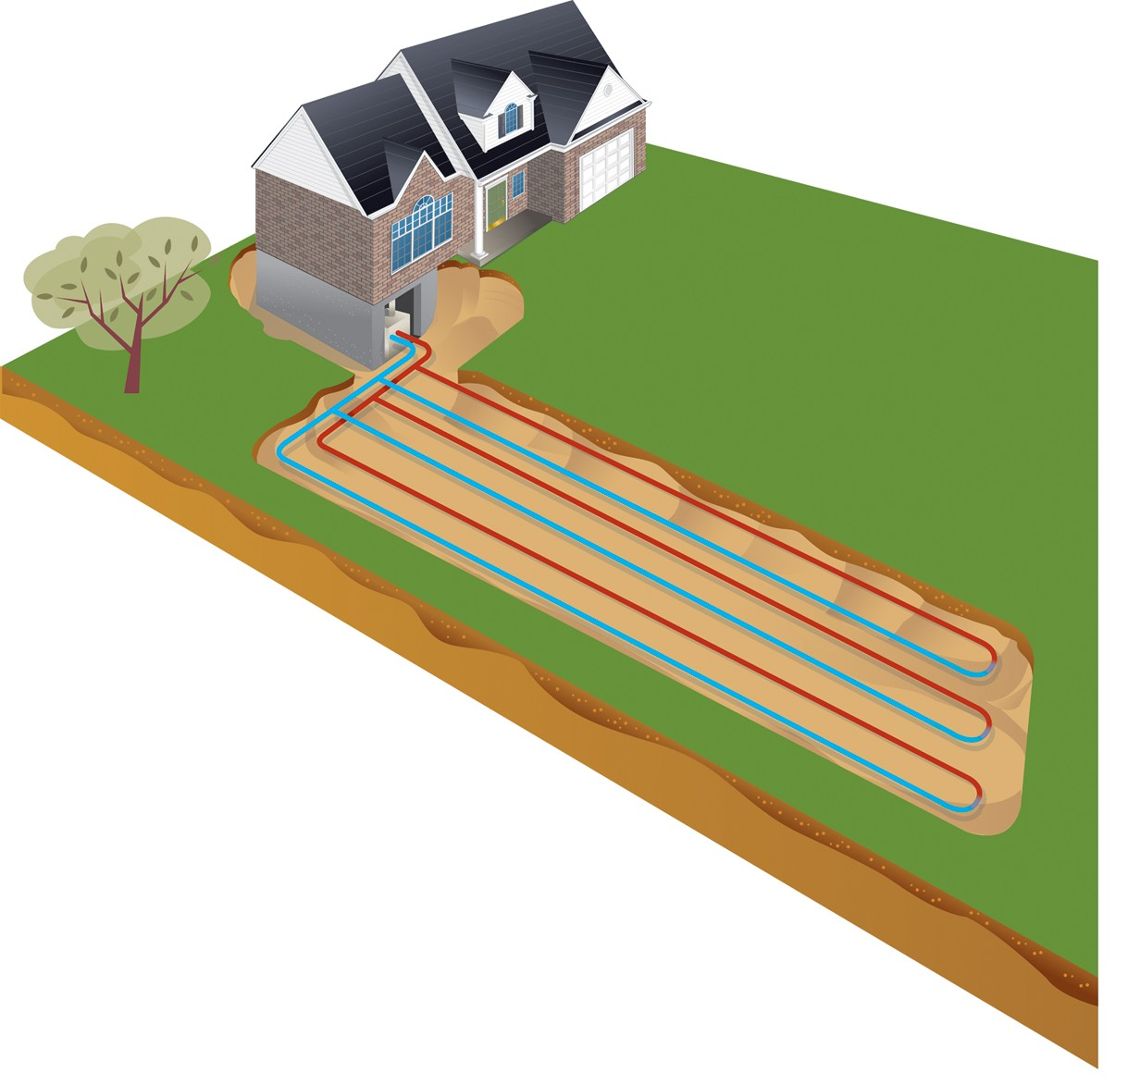
Challenges
http://www.mercuryrefrigeration.ca/index.php?page=geothermal
Background | Assess | Reduce | Generate | Offset | Results
Notes:
All points are going to spoken. No Slides needed.
What worked?
- Solar panels are a great way to generate electricity. The payback period for grid-connected panels is now less than the life of the panels, which makes them viable.
- Reducing electricity and gas usage can be done. Especially electricity.
What didn’t work?
- Wind power is not a viable option in GR due to low wind speeds and regulations against height of wind turbines.
What unique / unexpected challenge did you face?
- A lack of environmental resources (space).
- Roof space
- Yard space for geothermal
- Sunlight is inconsistent in snowy climates, no reliable PV generation in the winter.
Need bakcup electrical with Solar water heaters.
What’re the main takeaways from the project?
- Becoming net zero is very expensive today.
- A mixture of generation and reduction technologies is required.
- Reducing energy use can be done relatively inexpensive. Esp. Efficient lighting
- Insulation is more expensive, but pays back quickly and significantly reduces natural gas use.
Other comments / insights?
- Using solar and wind for energy production is intermittent. Grid connection is essential.
- Eliminating natural gas usage is a costly process with a long payback period due to the low price of natural gas today.
- Getting to net-zero has slightly less than 30-yr simple payback.

Slide 61
Takeaways
http://10-most.com/the-top-ten-most-expensive-things-in-the-world/
Background | Assess | Reduce | Generate | Offset | Results
Notes:
All points are going to spoken. No Slides needed.
What worked?
- Solar panels are a great way to generate electricity. The payback period for grid-connected panels is now less than the life of the panels, which makes them viable.
- Reducing electricity and gas usage can be done. Especially electricity.
What didn’t work?
- Wind power is not a viable option in GR due to low wind speeds and regulations against height of wind turbines.
What unique / unexpected challenge did you face?
- A lack of environmental resources (space).
- Roof space
- Yard space for geothermal
- Sunlight is inconsistent in snowy climates, no reliable PV generation in the winter.
Need bakcup electrical with Solar water heaters.
What’re the main takeaways from the project?
- Becoming net zero is very expensive today.
- A mixture of generation and reduction technologies is required.
- Reducing energy use can be done relatively inexpensive. Esp. Efficient lighting
- Insulation is more expensive, but pays back quickly and significantly reduces natural gas use.
Other comments / insights?
- Using solar and wind for energy production is intermittent. Grid connection is essential.
- Eliminating natural gas usage is a costly process with a long payback period due to the low price of natural gas today.
- Getting to net-zero has slightly less than 30-yr simple payback.

Slide 62
Take Home Message
Take small steps toward energy efficiency
http://superfastlinkbuilding.com/wp-content/uploads/2012/04/How-Green-Affiliate-Marketing-Can-Grow-Your-Sustainable-Business-1.jpg
Background | Assess | Reduce | Generate | Offset | Results
Notes:
Space Confinement issues
Horizontal Loop is inexpensive if home has the space

Slide 63
Take Home Message
http://assets.inhabitat.com/wp-content/blogs.dir/1/files/2011/08/Zimbabwe-CLF-bulb-exchange-3-537x402.jpg
Background | Assess | Reduce | Generate | Offset | Results
Notes:
Space Confinement issues
Horizontal Loop is inexpensive if home has the space

Slide 64
Take Home Message
Cooper
Background | Assess | Reduce | Generate | Offset | Results
Notes:
Space Confinement issues
Horizontal Loop is inexpensive if home has the space

Slide 65
Take Home Message
http://www.ci.bellaire.tx.us/index.aspx?NID=917
Background | Assess | Reduce | Generate | Offset | Results
Notes:
Make sure your home is properly insulated

Slide 66
Take Home Message
http://www.realestate.com.au/blog/a-household-history-of-the-fridge-2/
http://www.geappliances.com/appliances/refrigerators/cafe-hot-water-french-door-refrigerator/
Background | Assess | Reduce | Generate | Offset | Results
Notes:
Make sure your home is properly insulated

Slide 67
Background | Assess | Reduce | Generate | Offset | Results
Notes:
Make sure your home is properly insulated

Slide 68
Take Home Message
“The choice you make that will have the biggest impact on your environmental footprint is what kind of house you live in.”
- Professor Heun
http://2.bp.blogspot.com/-WQcK_tUJq2M/UR49huX812I/AAAAAAAAFoo/oDNyAeYhV5A/s1600/Sustainable-Home.png
Background | Assess | Reduce | Generate | Offset | Results
Notes:
Make sure your home is properly insulated

Slide 69
Net-Zero House Study
Engineering 333 Class Project
Senior Mechanical Engineering Students
12/02/2014

Slide 70
Compiled Technology Payback

Slide 71
Compiled Technology Payback

Slide 72
Payback Period – Electricity

Slide 73
Payback Period – Gas

Slide 74
Payback Period – Renewable Energy

Slide 75
Payback Period – Renewable Energy

